Slide 1
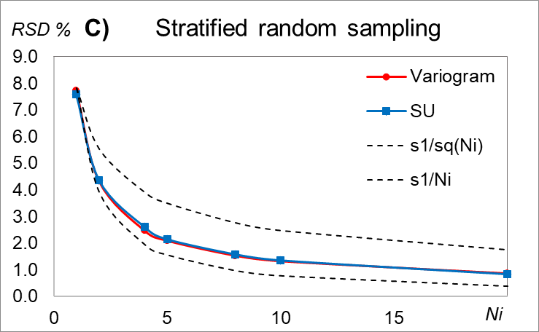
Extensions to the Theory of Sampling 2.
The Sampling Uncertainty (SU), and SU as alternative to variographic analysis
Bo Svensmark
Assoc. Prof. emeritus, Ph.D.
Analytical Chemistry,
Environmental Chemistry and Physics
Department of Plant- and Environmental Science

Slide 2
The Sampling Uncertainty SU
Introduction:
Pierre Gy’s Theory of Sampling has been a part of the curriculum in analytical chemistry at University of Copenhagen since 1998.
This work is the result of considerations regarding how to understand and explain the correct sampling errors FSE and GSE
The Sampling Uncertainty, SU
Validation by comparison of SU and variograms
1-dimensional sampling
2-dimensional sampling
The Correct Sampling Uncertainty, CSU
Conclusion

Slide 3
The Sampling Uncertainty SU
SU is derived from the distributional heterogeneity
Heterogeneity of one group:
For SU a group is redefined from one increment to one sample, i.e. all the increments in one sample.
The Sampling Uncertainty is the correct sampling uncertainty caused by the combined properties of
the material in the lot and
the sampling protocol
One group is one increment
One group is one sample
The Sampling Uncertainty SU is simply the standard deviation for all potential samples in a lot:
N_{g} is the number of potential samples

Slide 4
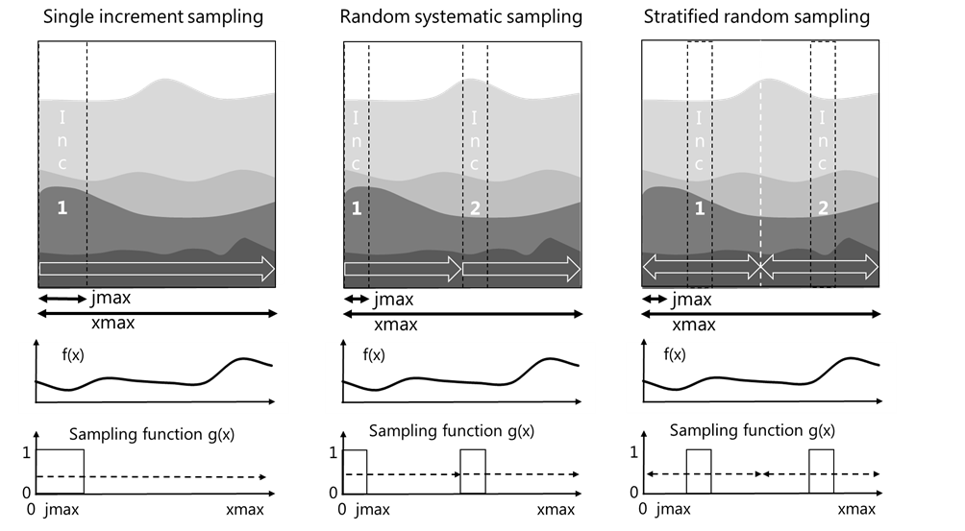
Potential samples
Random sampling: All positions without overlap
The mathematical sampling is equivalent to circular convolution:
a(x) = f(x)⋅ g(x)
a(x): the output
f(x): the input
g(x): the sampling function
Single increment sampling is equivalent to box-car averaging
Samples are taken starting from all positions within the lot (left side of the increments)

Slide 5
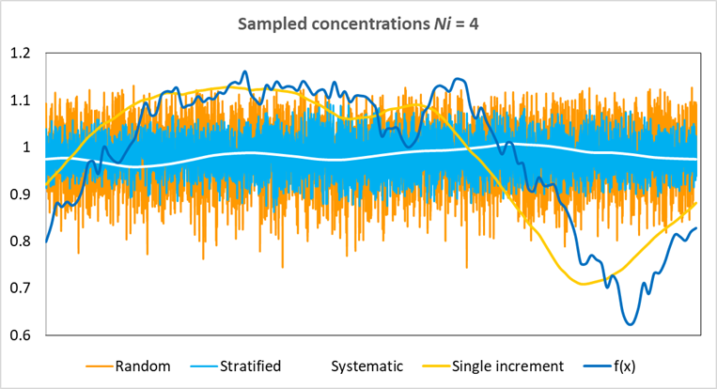
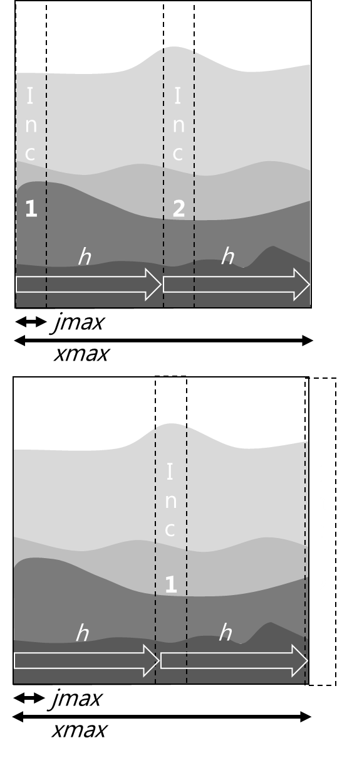
Potential samples
For all i = 1 to h
a_{i} : Concentration in each sample
i : Start position of an increment
jmax : Width of one increment, jmax = xmax/(ratio⋅ni)
ni : Number of increments
h : Distance between increments, h = xmax/ni
ratio : Sampling ratio, M_{Lot}/M_{Sample}

Slide 6
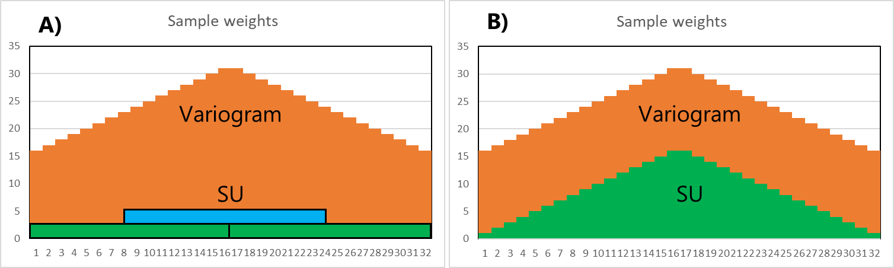
Comparison of results from SU and variographic analysis
For random systematic sampling uncertainties predicted from variogram are not correct in case of:
Trends in data
Cyclic variations
Low nugget effects
Non-stationarity of standard deviation in input data
(See the poster Applications of SU)
(See supplementary materials)
For stratified random sampling, random sampling and single increment sampling, uncertainties predicted from variograms are correct (apart from point 4).
For variograms the samples in the centre of the input contributes with the double weight of the samples at the end of the data.
Unfortunately SU can newer have the same weights as variograms
When SU is calculated the whole length of the data, all samples in the input have the same weight, i.e.
with the same probability in accordance with the fundamental sampling principle

Slide 7
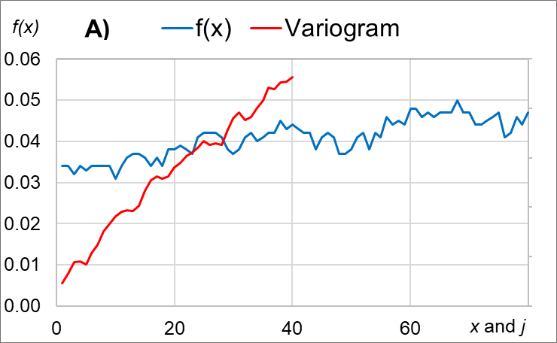
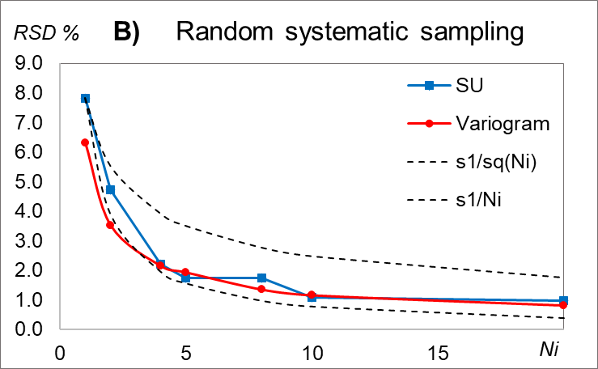
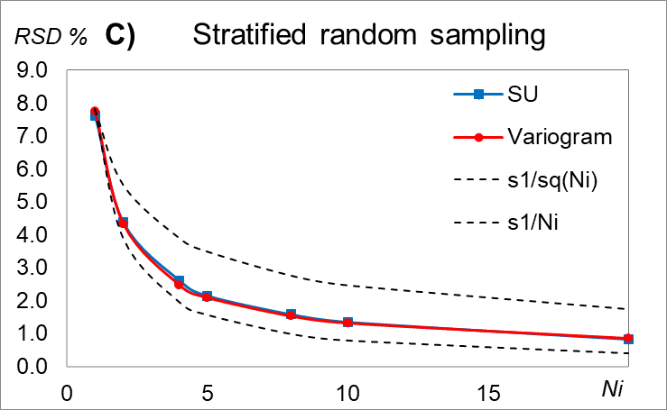
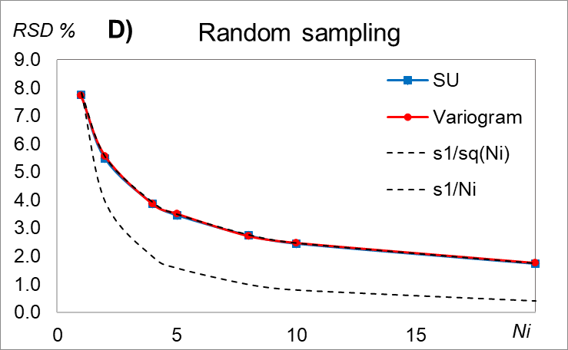
SU vs variograms – effect of trends in data
The results from the variogram is to be too low for small Ni. The reason for this is trend in data
SU for random systematic sampling is very sensitive to even small cyclic variations in data
For stratified random and random sampling the results from SU and variograms are almost identical
Data from Pitard 1998

Slide 8
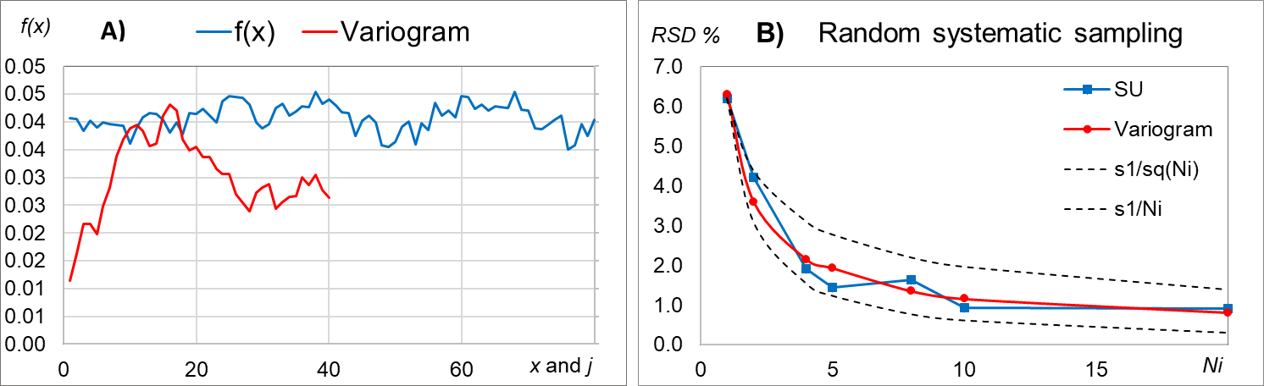
SU vs variograms – without trends in data (slope f(x) = 0)
Without trends in data SU and variograms give essentially the same results for all sampling methods

Slide 9
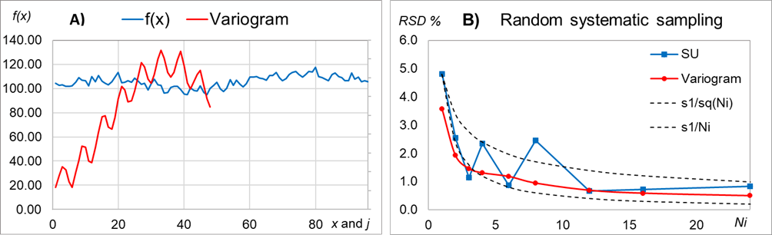
SU vs variograms – effect of cyclic variations
Cyclic variation with a period of j = 6
The numeric double integration of the variogram is intended to remove noise, but unfortunately it also levels out cyclic variations
Sampling with a period equal to that of the signal will give a maximum variation of the mean (j = 6 or 12 corresponding to Ni = 8 or 4), exactly as seen in the SU predictions

Slide 10
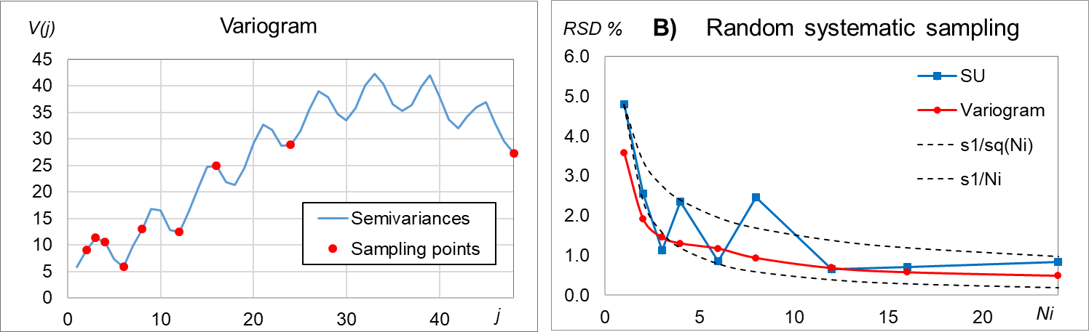
SU vs variograms – effect of cyclic variations
6 12 24 48
Cyclic variation with a period of j = 6
For cyclic variations:
Always sample at lags with maximum semivariance
Never at minimum semivariance!

Slide 11
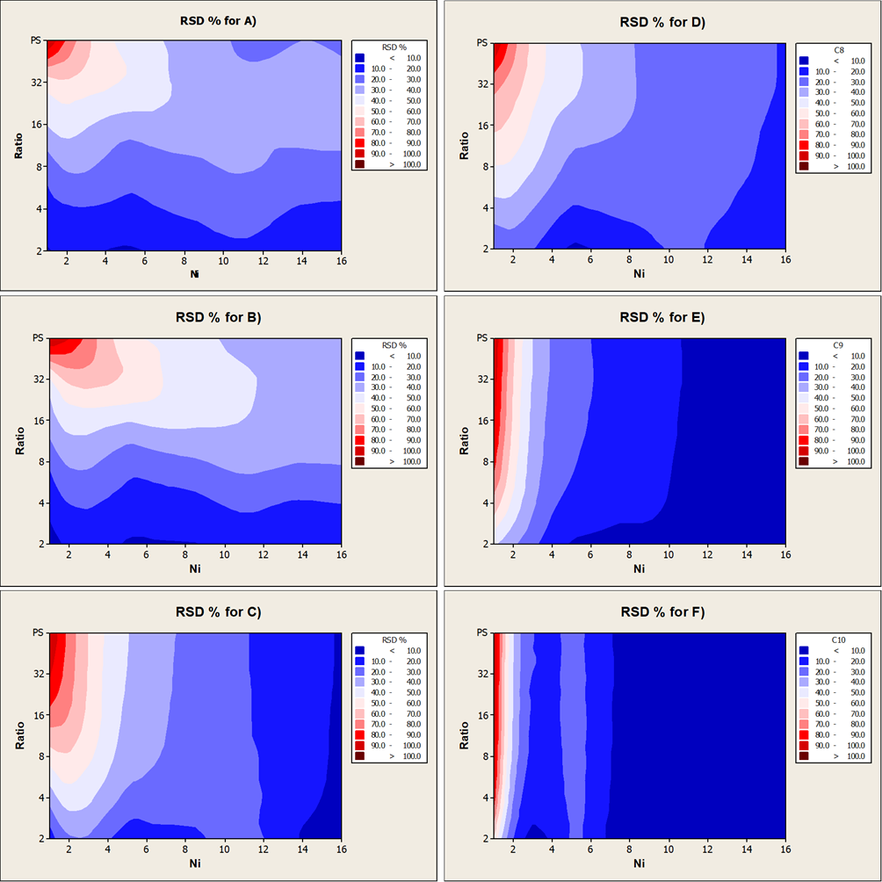
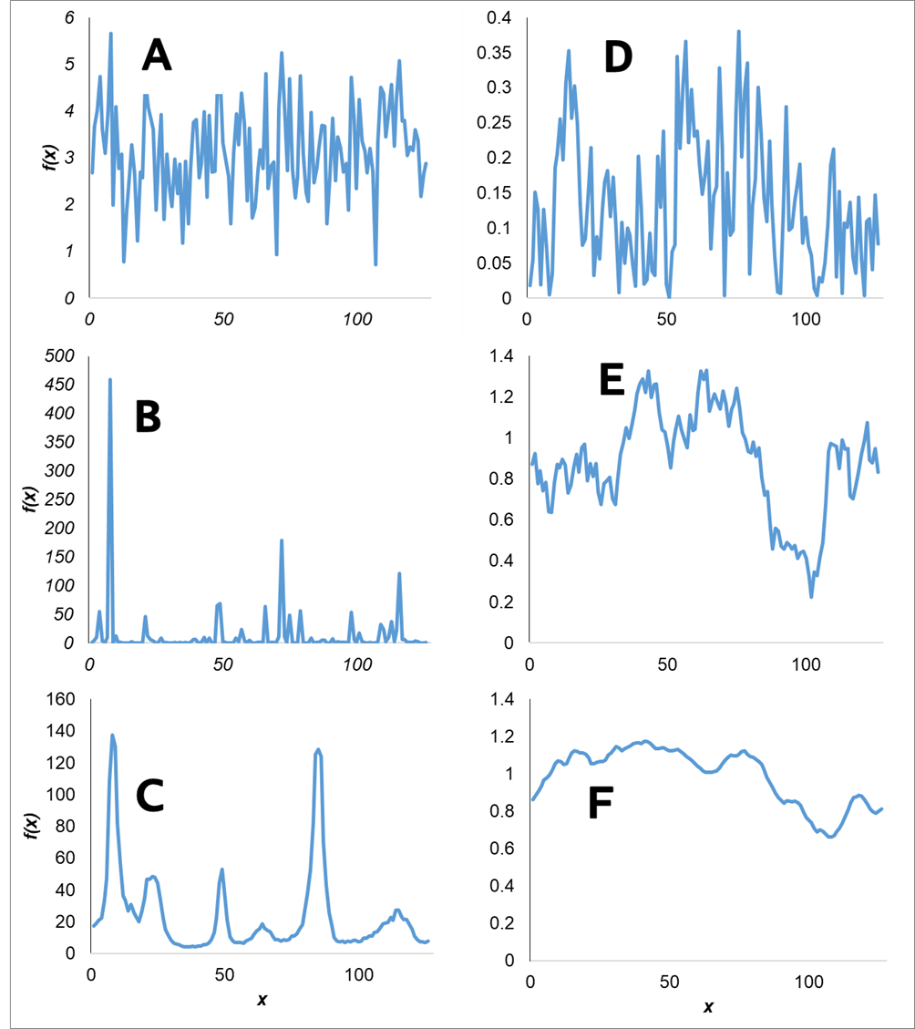
SU for composite sampling 1
Random noise with mean = 3 and s = 1;
Log-normal random distribution f(x) = 10^{A-3}
Smooth log-normal random distribution;
to F) Weak D to strong autocorrelation F
The effect of number of increments and
sampling ratio for stratified random sampling

Slide 12
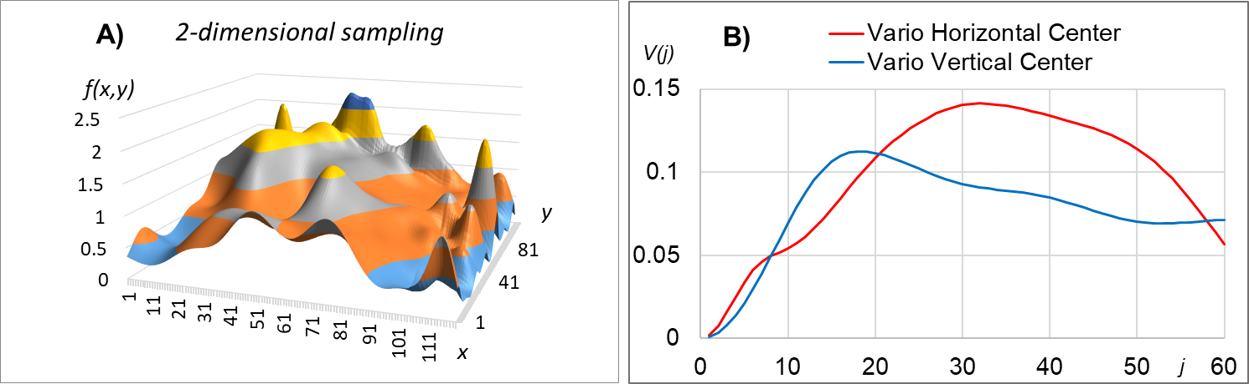
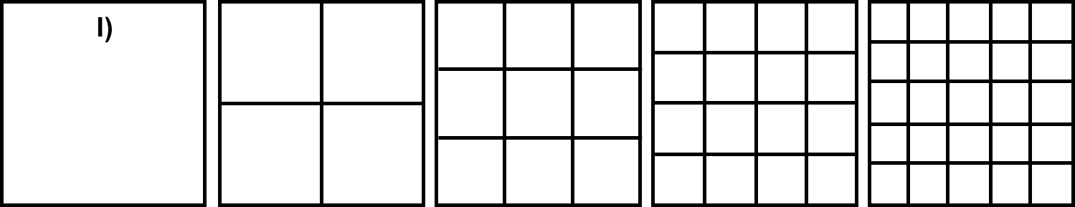
SU for 2-dimensional sampling
C)
Data for 2-D sampling
1-D Variograms at the centre positions of the data
Strata for sampling with 1, 4, 9, 16 and 25 increments

Slide 13
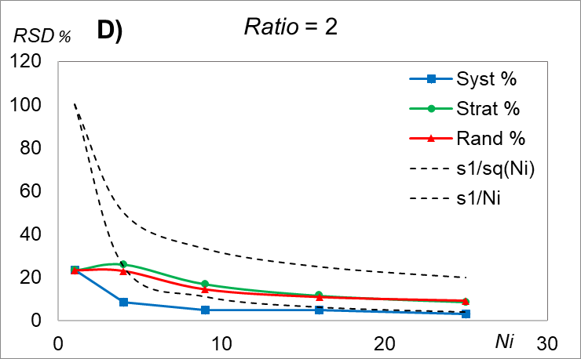
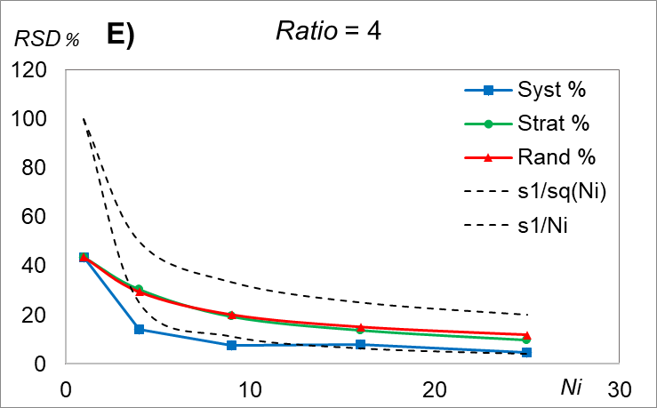
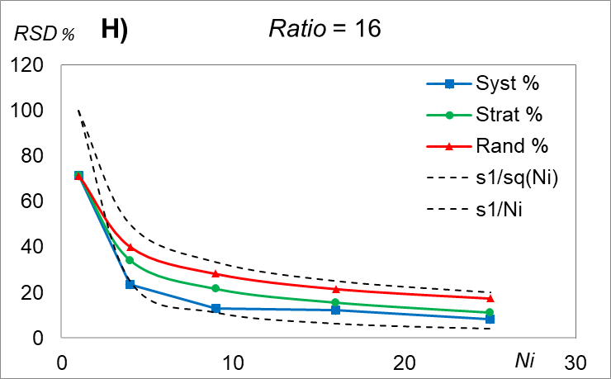
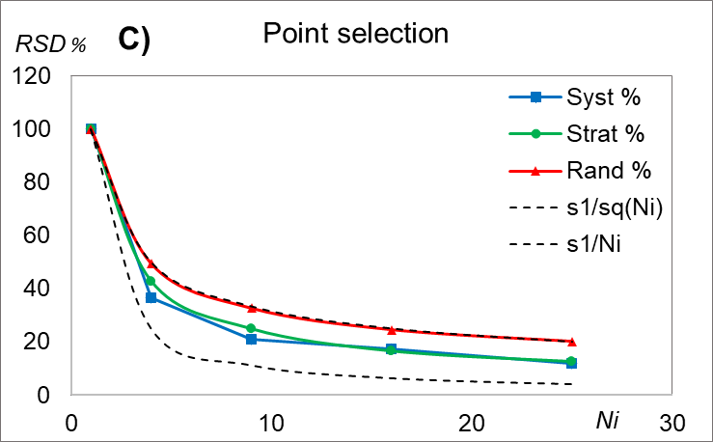
SU for 2-dimensional sampling
RSD % in % of RSD for the lot
Stratified random sampling is similar to random sampling for low sampling ratios
The number of increments have low effects except from 1 to 4 mostly for random systematic sampling
For point selection random stratified and stratified random sampling are similar
SU can also be applied quantitatively to 2-dimensional lots which is an extension to TOS

Slide 14
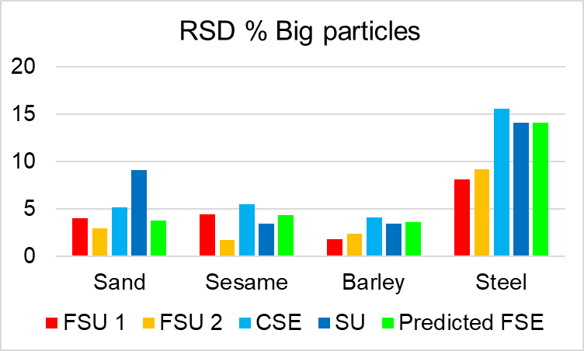
The Correct Sampling Uncertainty – FSU, GSE and SU
Sampling 125 g from 1000 g using a riffle splitter with 18 chutes of a mixture of:
5 % Sand
5 % Sesame seeds
70 % Barley grains
20 % Steel balls of d = 0.6 cm
FSE is predicted by the Extended Gy’s formula
GSE is predicted by SU next slide
(FSU) Observed :
TSE < FSE
(CSE) Observed:
TSE = GSE + FSE
(SU) Observed:
TSE ~FSE
Except for Sand
Predicted FSE and FSU: See my poster The Extended Gy’s formula

Slide 15
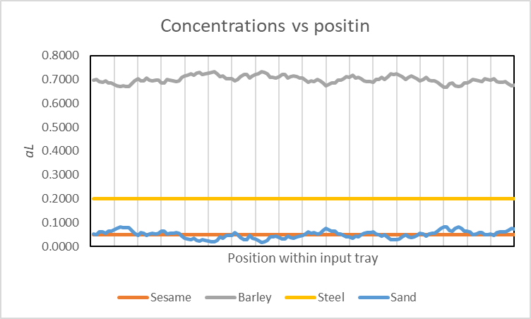
Estimation of GSE or TSE by SU
The observed results can be predicted by SU + FSU
In this case the data (concentrations) for estimation of SU do not include effects of FSE
SU = s(GSE)
If data includes effects of FSE (and long term sampling errors like in data for variograms)
SU = s(TSE)

Slide 16
Conclusion
SU can be used for 1-dimensional sampling and does not suffer from the problems with:
non-stationarity
cyclic variations
low nugget effects
Variograms (and Discrete Fourier Transform) should always be calculated to characterize heterogeneity
SU for random systematic sampling is very sensitive to even small cyclic variations
This indicates that random systematic sampling should be used with care
Stratified random sampling may in most cases be more reliable
SU can also be applied quantitatively to 2-dimensional lots.
This is an extension to TOS which only gives quantitative results for 0-D and 1-D sampling.
There are no limitations to the number of dimensions that can be used for SU
SU is very well suited for pedagogical purposes:
All aspects of grouping and segregation and distributional heterogeneity can be simulated by SU + FSU
The benefits of composite sampling can be shown by real numbers

Slide 17
Conclusion – Effects of segregation
To minimize the
sampling uncertainty
TSE = GSE + FSU
Minimize:
GSE: Mix horizontally
FSU: Separate vertically
(for vertical increments...)
‘FSE’ estimated by FSU
SEPARATE
GSE estimated by SU
All effects of segregation can be estimated or simulated by SU +FSU
Input is a table or map of concentrations (SU) or fragment classes (SU + FSU) as function of position
MIX

Slide 18

Excel spreadsheets for SU, FSU and the extended Gy’s formula
SU for 1-D sampling
SU for 2-D sampling
SU and variographic analysis
SU and FSU for CSU
All inclusive variograms and
Discrete Fourier Transforms
The extended Gy’ formula
Fundamental Sampling Uncertainty
B. Svensmark, Toolbox for analytcal chemistry, bosvensmark.dk, 2022

Slide 19

Thank you for
your attention!

