Slide 1
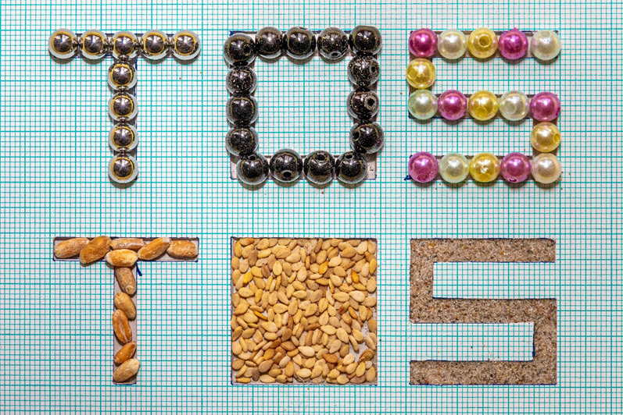
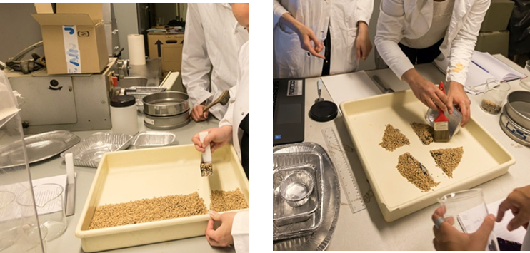
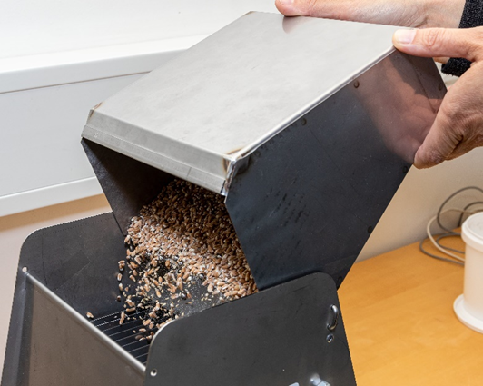
Extensions to the Theory of Sampling 1
The extended Gy’s formula and the segregation paradox, and the Fundamental Sampling Uncertainty (FSU)
Bo Svensmark
Assoc. Prof. emeritus, Ph.D.
Analytical Chemistry,
Environmental Chemistry and Physics
Department of Plant- and Environmental Science

Slide 2
The extended Gy’s formula, the segregation paradox and FSU
Introduction:
Pierre Gy’s Theory of Sampling has been a part of the curriculum in analytical chemistry at University of Copenhagen since 1998.
This work is the result of considerations regarding how to understand and explain the correct sampling errors FSE and GSE
Gy’s formula
The extended Gy’s formula
Validation experiment
Example: soil sampling
The segregation paradox
The Fundamental Sampling Uncertainty FSU
Conclusion

Slide 3
Gy’s formula
x
x
ρ: density, g⋅cm⁻³
a_{L}: Conc. Lot, g⋅g⁻¹
α: Conc. Ana., g⋅g⁻¹
M_{s}: Sample mass, g
M_{L}: Lot mass, g
Average volume of a fragments, cm³
Analyte Matrix
Concentration factor, g⋅cm⁻³
Pierre Gy developed the Theory of Sampling based on sampling in the mining industry, for which purpose Gy’s formula is fine
Pierre Gy
(1924 -
2015)
For sampling in general there are limitations:
Only valid for binary mixtures
Only one class of fragments can contain analyte
Volume of analyte containing fragments and matrix must be similar
The size distribution factor g is difficult to estimate in many cases

Slide 4

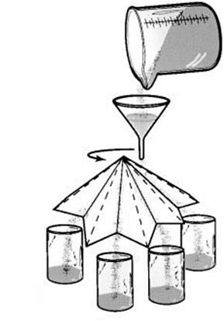
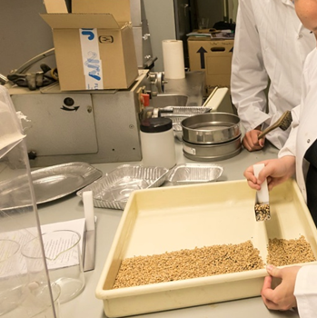

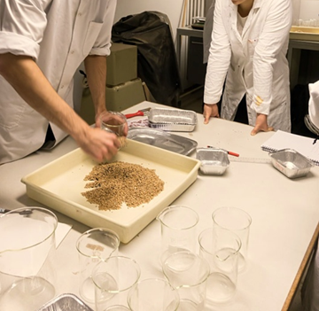
Sampling experiment in sampling course
Take a sample of ~125 g from a lot of 1000 g containing:
Barley grains Sesame seeds Sand
800 g 150 g 50 g
820 g 120 g 60 g
Using either:
Riffle splitter Paper cone Fractional Coning & Grab sampling
divider shovelling Quartering
Inspiration: L. Petersen, C.K.Dahl and K.H. Esbensen, Representative mass reduction in sampling – a critical survey of techniques and hardware, Chemometrics and Intelligent Laboratory Systems, 74 (2004) 95-114

Slide 5
Typical results of sampling experiment
The Fundamental Sampling Error (FSE) is the same for all metods, so the difference must be due to:
Grouping and Segregation Error
Incorrect Sampling Errors
Q1: Is there Grouping and Segregation and Incorrect Sampling Errors for the Riffle splitter?
(i.e. how do the experiment compare to theory?)
The standard deviation s % due to FSE can be predicted by Gy’s formula, but only for binary mixtures, so what do we do?
A1: Use the Extended Gy’s formula*– next slides…
*B. Svensmark 2021, Extensions to the Theory of Sampling 1. The extended Gy’s formula, the segregation paradox and the fundamental sampling uncertainty (FSU), Anal. Chim. Acta 1187 (2021) 339127, doi.org/10.1016/j.aca.2021.339127

Slide 6
Derivation of the extended Gy’s formula
Sum over all fragments i in the lot:
N_{F}: Number of fragments
a_{i}: Concentration in fragment i, g⋅g⁻¹
a_{L}: Concentration in the lot g⋅g⁻¹
m_{i}: Mass of fragment i, g
M_{L}: Mass of the lot, g
3 assumptions:
Gy’s formula
1 assumption: The lot can be divided into k classes of fragments with similar properties
(an example: Barley grains, Sesame seeds, Sand)
The Extended Gy’s formula:
Sum over k classes of fragments:
m_{k}: Mass of a single fragment of class k
a_{k}: Concentration in class k
x_{k}: Mass fraction of class k, x_{k} = M_{k}/M_{L}

Slide 7
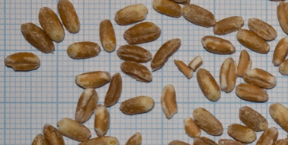
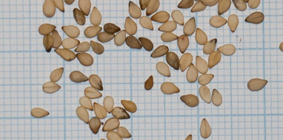
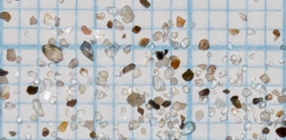
The Extended Gy’s formula for the sampling experiment
Barley Sesame Sand
m_{k}, g 0.045 0.003 0.0001
x_{k} 0.82 0.12 0.06

Slide 8
Observed vs predicted s % for the Riffle splitter
Very good agreement:
No or very little GSE or Incorrect Sampling Errors!
Sand (and sesame) has the a little GSE

Slide 9
Properties of the extended Gy’s formula
1) It is exact – no assumptions have been made starting from Gy’s definition of constitutional heterogeneity to the extended formula, except that the lot can be divided into classes with fragments with similar properties within each class.
2) It is very general. The lot can have two or several classes with different analyte concentrations a_{k} (from zero for matrix to 1 for pure analyte fragments).
3) It is simple and flexible. The operator can estimate the fragment mass in each class by any method of preference – experimentally by weight, from table values of volume and densities, using Gy’s parameters, fgd³ρ, or by any other method. It is important to remember that the results will be as exact as the estimate.
4) A requirement is that the sum must contain all classes making up the lot, i.e. the sum of all x_{k}’s should add up to 1,

Slide 10
Validation experiment
Sampling 125 g with a Riffle splitter with 18 chutes from 1000 g of the following mixtures:
Plastic, Glass and Steel are spherical balls with a diameter of 6 mm
The sample was ‘analyzed’ by careful sieving using a 4 mm, a 2 mm and a 1 mm sieve and weighting of the 3 or 4 fractions

Slide 11
Validation results (n = 8)
Very good agreement
Very good agreement
All standard deviations increases app. as expected
Very good agreement except for sand
Note that s(obs) < s(Predicted), except for sand
For #7:
Very good agreement for barley and steel
For sand s(obs) >> s(predicted)
For #8:
Good agreement
All s(obs) slightly higher due to GSE
These experiments strongly supports the validity of the extended Gy’s formula.

Slide 12
An example: Soil sampling
Soil parmeters*
Q2: The sizes in the texture is the maximum size of the class. Which size should be used in the formula?
(d = d_{max} would give too high variance)
A2: Use the mass average mass of the fragments
(d_{n}: nominal diameter of class k, cm)
For a uniform distribution of diameters, the nominal diameter of a class is calculated by simple integration:
d_{k} : Upper diameter
d_{l} : Lower diameter
The granulometric factor:
Combination gives:
Note that for d_{k} >>d_{l} g ~ 0.25, i.e. the value suggested by Pierre Gy when d_{k}/d_{l} > 4
*Texture from: Styrishave et al., The Spatial Heterogeneity of Polycyclic Aromatic Hydrocarbons in Soil Depends on Their Physico-chemical Properties, Water Air Soil Pollut. 223 (2012) 969-977, except that gravel with d>0.2 mm is excluded

Slide 13
An example: Soil sampling
Soil parmeters*
OBS! This is the sampling uncertainty due to the constitutional heterogeneity, i.e. caused by the fragments of the lot being different.
For real samplings we should add the contribution from the Grouping and Segregation Error:
*Texture from: Styrishave et al., The Spatial Heterogeneity of Polycyclic Aromatic Hydrocarbons in Soil Depends on Their Physico-chemical Properties, Water Air Soil Pollut. 223 (2012) 969-977, except that gravel with d>0.2 mm is excluded

Slide 14
The validation experiment #3, #5 and #6?
9 out of 12 observed standard derivations are much smaller than predicted!
Q3: What is the explanation for s(observed) < s(FSE)?
A3: The segregation paradox:
Segregation or separation of the lot in a direction parallel to the sampling increments can reduce the sampling uncertainty to well below the Fundamental Sampling Error

Slide 15
Normal operation of the Riffle splitter
The distribution of the particles in the mixture of barley, sesame, sand and steel or glass are not stable.
Under the influence of gravity and vibrations, the heavy particles will seek to the bottom of the container, and the less dense particles will concentrate in the top layer.
This is amplified during the tipping of the input tray in normal operation of the Riffle splitter.
Thus the mixture is partly separated so sesame and barley have a decreasing concentration with time while sand and steel or glass have an increasing concentration with time – there is a separation in a direction parallel to the chutes of the Riffle splitter.
Now the analyte and the matrix are partly separate from each other, thus the sampling variance is smaller because of fewer contributions to the variance – and the sampling uncertainty is < s(FSE).
A mixture has a higher heterogeneity than a material, where the different classes of particles are separated.

Slide 16
An explanation by the simplified extended Gy’s formula
When the analyte is only present in one of the classes of particles, the extended Gy’s formula can be simplified to:
This formula is equivalent to Gy’s formula, except:
there may be more than 1 matrix class
The volume of analyte and matrix fragments may be different
a: analyte m: matrix
Note that the result is independent of the analyte concentration
It only depends on the class fractions x_{k}
When the analyte amount increases, both terms decreases
The analyte term because 1/x_{a} decreases more than x_{a} increases
The matrix term because x_{m} decreases
Q4: UPS, in the part of the lot, where the analyte amount is decreased, the effect is opposite?
A4: Yes, but the effect is less, because the effect should be weighted by the amount of analyte in each position within the lot

Slide 17
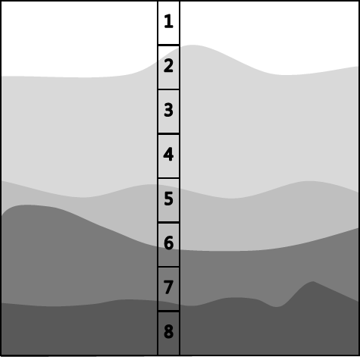
Prediction of the effect of the segregation paradox
The sampling uncertainty caused by fragments being different, can be predicted for scenarios, where the amount of each class is given as function of position within the sample
This is called the Fundamental Sampling Uncertainty, FSU
FSU takes the sampling orientation into account
FSE is the uncertainty for a mixed sample
Position j = 1 to 8
Unfortunately, in TOS many uncertainties are called errors. FSE is also an uncertainty and not an error:
Errors can be avoided or maybe corrected
Uncertainties can be diminished but not correted
Incorrect sampling errors are errors
Correct sampling errors are uncertainties

Slide 18
Predicted and observed results for the segregation paradox
Perfect agreement with theory
But remember, that many distributions may give the same result
This only shows that the segregation paradox can explain the results, not that the distribution is exactly as shown
Q5: How was the other, very good, results in the validation experiment obtained?
A5: By a modified ‘at once’ operation of the Riffle splitter

Slide 19
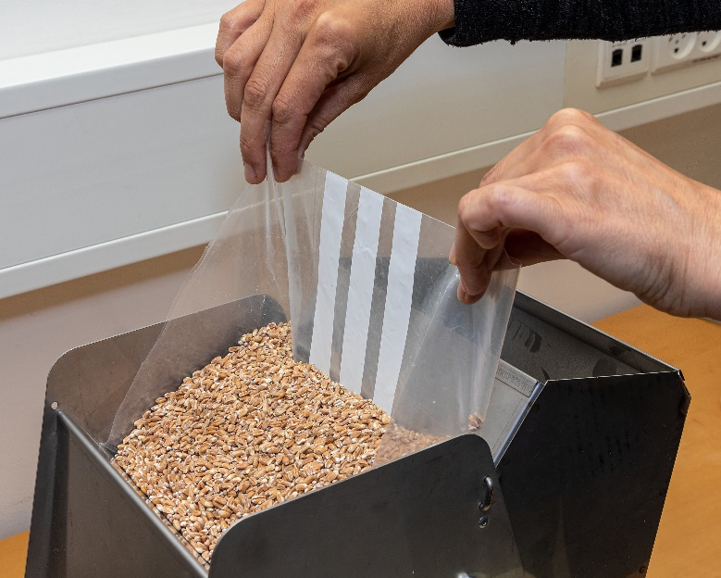
‘At once’ operation of the Riffle splitter (experiment #3, 8 & 9)
The entry to the chutes were covered by a plastic bag
The mixture were applied on top of the plastic
The plastic were removed rapidly
In this way the lot is introduced as a mixture with no or little time to separate
s(observed) were now close to s(FSE)
Q6: What about the normal Grouping and Segregation Error?
A6 a): It is important to mix the mixture in the direction perpendicular to the chutes to get an even distribution of fragments along this direction
A6 b): B. Svensmark, Extensions to the Theory of Sampling. 2. The Sampling Uncertainty (SU), and SU as alternative to variographic analysis, Proceedings of the 10th World Conference of Sampling and Blending, 2022

Slide 20
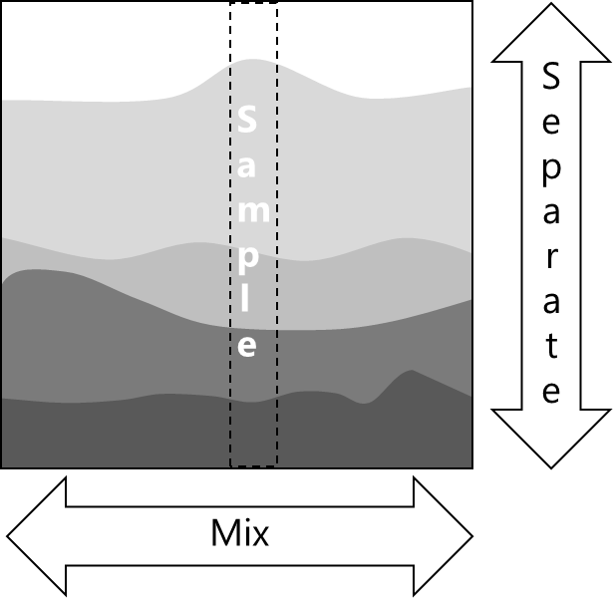
Conclusion – the segregation paradox
Segregation or separation of the lot in a direction parallel to the sampling increments can reduce the sampling uncertainty to well below the FSE
Separat the lot in a direction parallel to the increments in order to diminish the Fundamental Sampling Uncertainty
Mix the lot in the direction perpendicular to the increments
to get an even distribution of fragments to diminish the Grouping and Segregation Error

Slide 21
Conclusion – the simplified extended Gy’s formula
a: analyte m: matrix
This formula is equivalent to Gy’s formula, except that:
There may be more than 1 matrix class
The volume of analyte and matrix fragments may be different
The result is independent of the analyte concentration
It only depends on the class fractions x_{k}

Slide 22
Conclusion – the extended Gy’s formula
It is exact – no assumptions have been made starting from Gy’s definition of constitutional heterogeneity to the extended formula, except that the lot can be divided into classes with fragments with similar properties within each class.
It is very general. The lot can have two or several classes with different analyte concentrations a_{k} (from zero for matrix to 1 for pure analyte fragments).
It is simple and flexible. The operator can estimate the fragment mass in each class by any method of preference – experimentally by weight, from table values of volume and densities, using Gy’s parameters, fgd³ρ, or by any other method. It is important to remember that the results will be as exact as the estimate.
A requirement is that the sum must contain all classes making up the lot, i.e. the sum of all x_{k}’s should add up to 1,

Slide 23

Grab sampling?
Thank you for your attention!

Slide 24
Grouping and Segregation Error?
Q7: Can the Grouping and Segregation Error be predicted?
(Can the difference in s % for Sand be predicted?)
*
A7: Yes – by the Sampling Uncertainty SU
*B. Svensmark, Extensions to the Theory of Sampling. 2. The Sampling Uncertainty (SU), and SU as alternative to variographic analysis, Proceedings of the 10th World Conference of Sampling and Blending, 2022

Slide 25
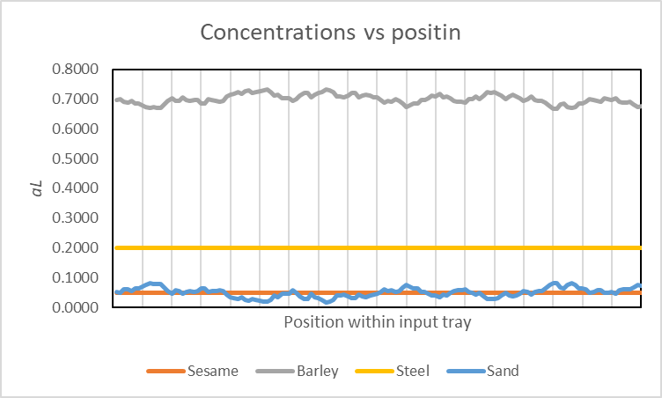
The Sampling Uncertainty, SU
Scenario with variations in concentration of sand and barley along the input tray in the Riffle splitter
The Grouping and Segregation Error s_{GSE} = s_{SU} under influence of concentrations as function of position and sampling increments, is calculated by a numeric method
The Correct Sampling Uncertainty CSU can now be calculated:
Nearly perfect agreement with theory
But remember, that many distributions may give the same result
This only shows that the CSU can explain the results, not that the distribution is exactly as shown

