Slide 1

Calculation of Ion Mobilities for MS - using mobcal
Bo Svensmark
RAACE - Analytical Chemistry
PLEN
University of Copenhagen
svensmark@plen.ku.dk

Slide 2
Simulation of gas chromatography using the Solvent Parameter model
Models
Prediction of Ion Mobility MS – mobcal

Slide 3
Observation
(Real world)
Conceptual model
(Chemistry)
Numerical model
(Simulation)
Mathematical model
(Mathematics)

Slide 4
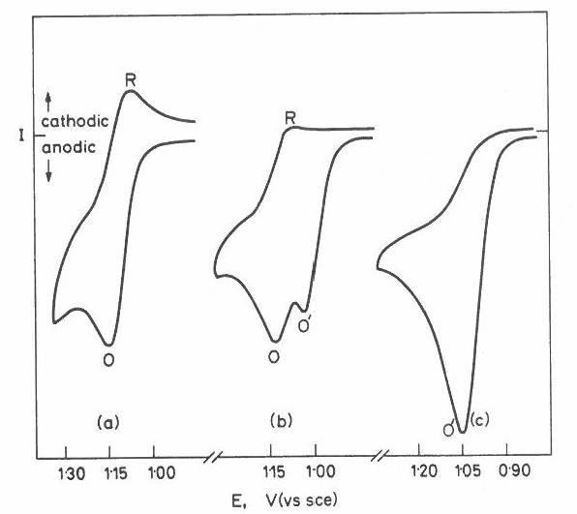
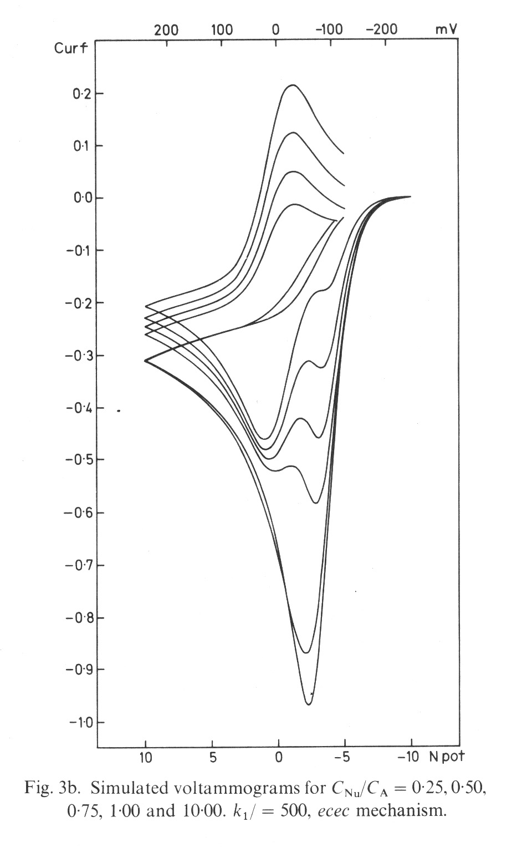
Organic electrochemistry
Mechanism
A + e⁻ ⇔ A^{.-}
A^{.-} + HS → AH. + S⁻
AH. + e⁻ ⇔ AH⁻
Simulation
(Fortran)
Experimental
Differential equations

Slide 5
Diffusion controlled currents
C, conc. At electrode
dC/dE
Current I

Slide 6
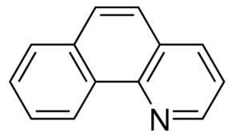
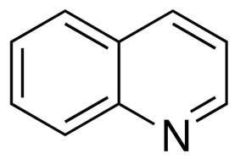
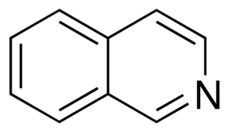
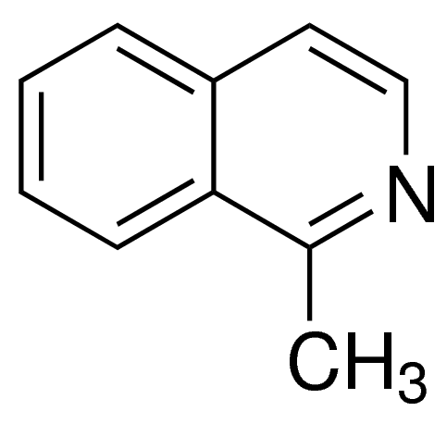
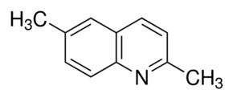
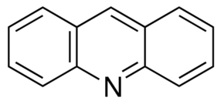
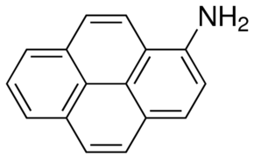
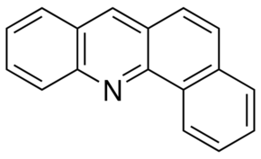
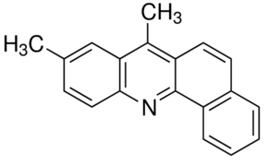
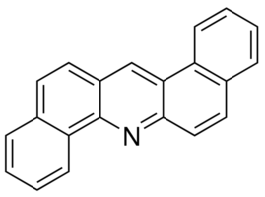
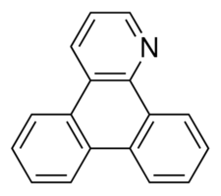
Ion Mobiity experimental data
Sofie Bruun Knudsen, ACN 28/11-2015

Slide 7
Calculation of Ion Mobilities - mobcal
Mobcal-program from Martin Jarrold's group: http://www.indiana.edu/~nano/software.html.
MOBCAL calculates theoretical collision cross sections by three methods:
Projection approximation (PA):
Exact hard-spheres scattering model (EHS):
Trajectory method (TM):
Of the three calculations, the trajectory method is the most rigorous. TM-derived cross sections are the most accurate
Mobcal: Fortran77 source code!

Slide 9
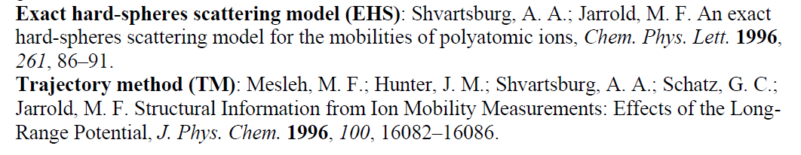
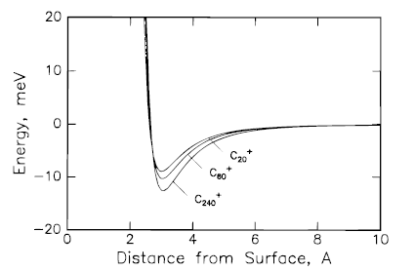
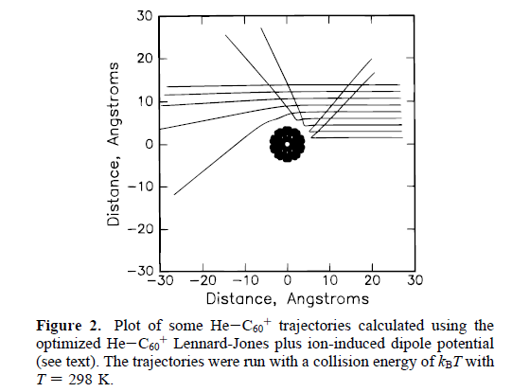
Lennart-Jones
Ion – Induced Dipole potential

Slide 10
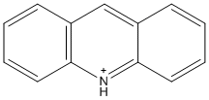
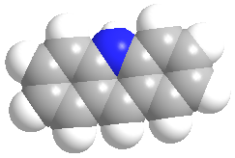
Input to mobcal
1) Draw the molecule with
ChemDraw:
2) Save the coordinates
3) Open in Chem3D and calculate atom charges
Calculations -> Extended Hückel -> Calculate Charges
4) Combine coordinates and charges in an
Input file for mobcal

Slide 11
Results

Slide 12
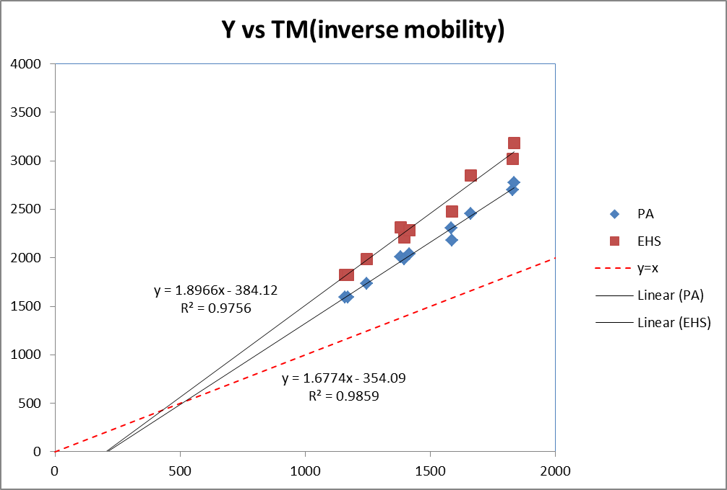
PA & EHS vs TM mobilities

Slide 13
Concluding remarks
The compiled program is 149 kb + Fortran library, and must be run at the Command Prompt at present (DOS)
Experimental mobilities are needed in order to know how good the predictions are
I may make an stand alone subroutine for Excel later on

Slide 14


