Slide 1
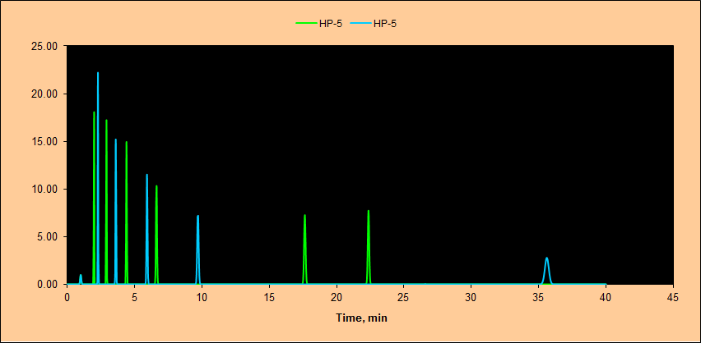
Models for (Gas) Chromatography based on Abraham’s model
Bo Svensmark
Analytical Chemistry
Environmental Chemistry and –Physics
Department of Plant and Environmental Sciences

Slide 2
Models for (Gas) Chromatography based on Abraham’s model
Processes in chromatography
  Adsorption
  Partition (Absorption)
Interactions in chromatography
Dispersive interactions
Polar interactions
Ionic interactions
Solubility Parameter models
  Hildebrand Solubility Parameter
  Hansen Solubility Parameters
The Solvation Parameter model
Overview
Solute parameters
Column parameters
Prediction of (gas) chromatograms
Conclusion

Slide 3
Processes in chromatography
Adsorption
on solid
GSC
Absorption
in liquid
GLC
Adsorption
on solid phase
NP
Absorption
in ‘liquid layer’
HILIC
Absorption
bonded phase
RP
Stationary phase support – often (SiO₂)_{n}
Adsorption or Absorption (Partition) or a mixture of both

Slide 4
Molecular polarity – dipole moments
Dipole moment: A vector from the centre of negative charge to the centre of positive charge in a molecule
δ-
δ-
δ-
Dipole moment = 1.85 D
Symmetric, no
Dipole moment
2δ+
δ+
δ+
δ-
Polarity according to dipole moments:
No dipole << small dipole moment < large dipole moment
Large dipole moments are often associated with heteroatoms
O, N, S and the halogens

Slide 5
Molecular polarity - polarizability
Induced dipole: The electron cloud in molecules with loosely bound electrons (double bonds, heteroatoms and lone pairs) may be polarized by neighbour molecules with a dipole moment or a charge.
δ- δ+
δ- δ+
δ- δ+
Even two polarizable molecules without permanent dipoles may induce dipoles in each other when they interact
δ- δ+
δ- δ+

Slide 6
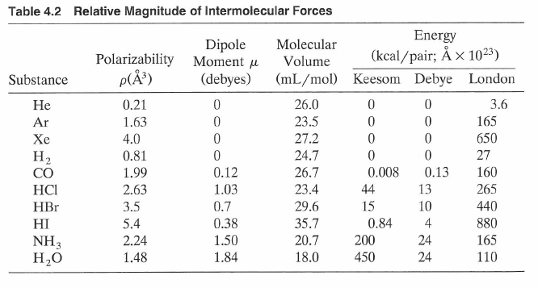
Weak interactions – van der Waals forces
Interaction | Type | Name
Dipole-dipole | Orientation | Keesom (1912)
Dipole-induced dipole | Induction | Debye (1920)
Induced dipole-induced dipole | Dispersion | London (1930)
δ_{p} Polar
δ_{d} Non-
polar
Energy ≈ 0.5 – 2 kJ/mol
Miller 2005

Slide 7
Medium strong interactions – hydrogen bonding
Hydrogen bound to an electronegative atom may form a relatively strong bond with a lone-pair or an electronegative atom in another molecule.
Hydrogen bonds:
O−H⋅⋅⋅⋅⋅:N 29 kJ/mol
O−H⋅⋅⋅⋅⋅:O 21 kJ/mol
N−H⋅⋅⋅⋅⋅:N 13 kJ/mol
N−H⋅⋅⋅⋅⋅:O 8 kJ/mol
Hydrogen bonds are stronger than van der Waals interactions, and they are directional like covalent bonds
But - the hydrogen bond is not at all as strong as a covalent bond:
Covalent bonds:
C−N 306 kJ/mol
C−C 348 kJ/mol
C−H 415 kJ/mol
C=O 608 kJ/mol
C≡N 888 kJ/mol

Slide 8
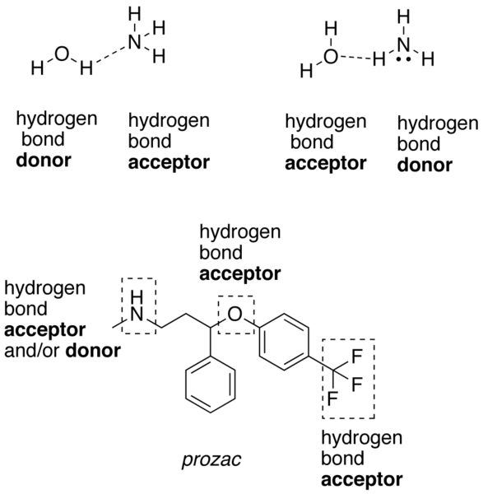
Medium interactions – hydrogen bonding
Wikipedia 2012

Slide 9
Medium to strong interactions - Ionic interactions
+
-
+
δ- δ+
The forces between ions and ions or dipoles depends very much on the dielectric constant of the solvent.
Interaction between ions:
k: 1.39⋅10⁻⁷ kJmol⁻¹m
z: Ion charge, dim. less
ε: Relative dielectric constant, dim. less
r: Distance between ions, m
For mono-charged ions in water, r = 3Å:
(k = k_{e}e²N_{A})
k_{e}: Coulomb’s constant
e: Charge of an electron
N_{A}: Avogadro’s number
For divalent ions in THF, r = 3Å:
Thermal energy:
25 ºC 3.7 kJ/mol
100 ºC 4.7 kJ/mol

Slide 10
Medium to strong interactions - Ionic interactions
+
-
+
δ- δ+
The forces between ions and ions or dipoles depends very much on the dielectric constant of the solvent.
Energy for monovalent ions:
Thermal energy: 25 – 100 ºC: 3.7 - 4.7 kJ/mol

Slide 11
Polarity types
Non-polar solutes: Dispersive interactions:
Induced dipole-induced dipole interactions
Polar solutes: Permanent dipoles:
Dipole-dipole interactions
Dipole-induced dipole interactions
Dipole-ion interactions
[+ Hydrogen bond formation]
Ionic solutes: Ion interactions:
Ion-ion interaction
Ion-dipole interactions
Ion-induced dipole interactions
Remember: Chromatography is dependent on the partition between two phases, which often differs in polarity
Thus the effect of a low solubility in one phase may be as important as the effect of a high solubility in the other phase

Slide 12
Solution of a molecule ( ) in a solvent ( )
First step:
Cavity formation and
solvent reorganisation
Second step:
Solvent-solution interactions
Evaporation of solute
Evaporation of solvent
A solvent with a high evaporation energy has a high potential for strong solute-solvent interaction.
If on the other hand, the solute has a low evaporation energy, its molecules has low potential for strong solute-solvent interactions.
The conclusion is, that molecules with similar evaporation energies for similar volumes will, most likely, be soluble into each other

Slide 13
Hildebrand Solubility Parameter*
Hildebrand Solubility parameter δ is the square root of the cohesive energy density, i.e. the energy that holds a unit volume of the solvent together (evaporation energy/molecular volume)
δ, cal^{½}cm^{-3/2} δ(SI), MPa^{½}
Solvent δ δ(SI)
n-Pentane (7.0) 14.4
n-Hexane 7.24 14.9
Freon® TF 7.25 -
n-Heptane (7.4) 15.3
Diethyl ether 7.62 15.4
1,1,1 Trichloroethane 8.57 15.8
n-Dodecane - 16.0
White spirit - 16.1
Turpentine - 16.6
Cyclohexane 8.18 16.8
Amyl acetate (8.5) 17.1
Carbon tetrachloride 8.65 18.0
Xylene 8.85 18.2
Ethyl acetate 9.10 18.2
Toluene 8.91 18.3
Tetrahydrofuran 9.52 18.5
Benzene 9.15 18.7
Chloroform 9.21 18.7
Trichloroethylene 9.28 18.7
Cellosolve® acetate 9.60 19.1
Solvent δ δ(SI)
Methyl ethyl ketone 9.27 19.3
Acetone 9.77 19.7
Diacetone alcohol 10.18 20.0
Ethylene dichloride 9.76 20.2
Methylene chloride 9.93 20.2
Butyl Cellosolve® 10.24 20.2
Pyridine 10.61 21.7
Cellosolve® 11.88 21.9
Morpholine 10.52 22.1
Dimethylformamide 12.14 24.7
n-Propyl alcohol 11.97 24.9
Ethyl alcohol 12.92 26.2
Dimethyl sulphoxide 12.93 26.4
n-Butyl alcohol 11.30 28.7
Methyl alcohol 14.28 29.7
Propylene glycol 14.80 30.7
Ethylene glycol 16.30 34.9
Glycerol 21.10 36.2
Water 23.5 48.0
*Joel H. Hildebrand 1936

Slide 14
Hansen Solubility Parameters*
Hansen divided the Hildebrand solubility into 3 parts:
δ_{t}: Hildebrand Solubility parameter (total)
δ_{d}: Dispersion parameter (non-polar interactions)
δ_{p}: Polar interactions (dipole, lone pairs, π-electrons)
δ_{h}: Hydrogen bond interactions (acid and/or basic)
First, δ_{t} is divided into dispersion (δ_{d}) and the polar interactions (δ_{p} and δ_{h}) by help of the Homomorph method (Blanks 1964):
Dispersion δ_{d} is set equal to δ_{t} for an alkane with the same size and shape as the solute (a homomorph). δ_{d} is thus the dispersion part of δ_{t}.
The rest (δ_{t}² - δ_{d}²) is the polar interaction, which is divided into a polar part δ_{p}, and a part due to hydrogen bonds δ_{h}, by trial and error experiments.
*Charles M. Hansen, Dissertation, Danmarks Tekniske Højskole (DTU) 1967

Slide 15
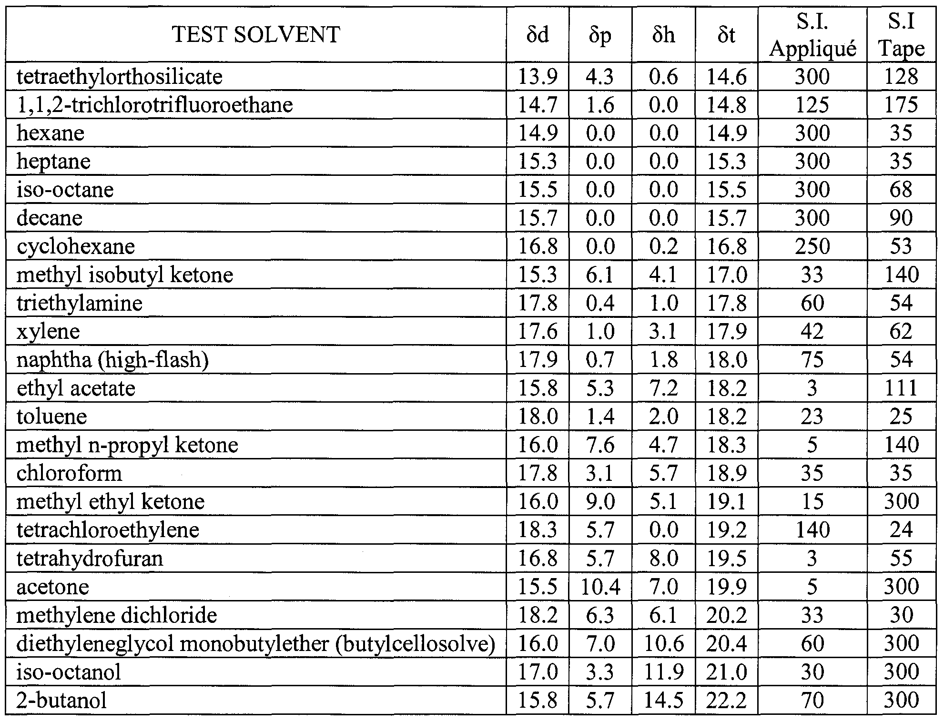
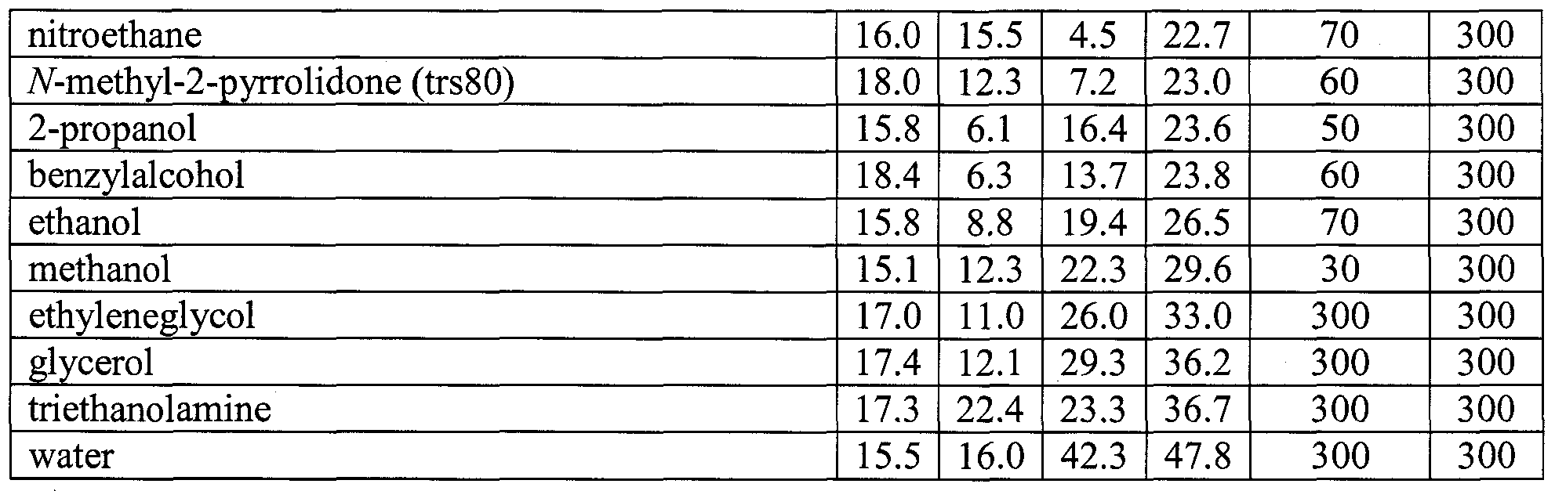
Hansen Solubility Parameters
Solubility of a solute in a solvent can be estimated from their “distance” in a 3-D space according to:
Solutes with small R_{a} will most likely be soluble in the given solvent.
(R_{a} should be compared to an “solubility sphere” radius R₀, which for each molecule is determined (by trial and error) as the maximum radius R_{a}, for which other molecules are soluble)
See also:
http://hansen-solubility.com/index.html
http://pirika.com/ENG/HSP/index.html

Slide 16

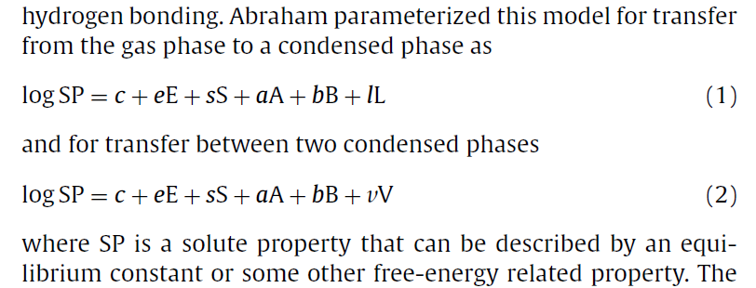
Abraham’s model
Michael H. Abraham
Honorary Professor
The University College
London, UK
M.H. Abraham has more than 860 references in SciFinder, and in many of the earlier articles different nomenclatures were used, e.g.
But – in all case, the model is a linear-free-energy relationship with 5 parameters for solutes and 6 parameters for solvents or columns
The model can be used for GC, HPLC and for solubilities etc.

Slide 17
The Solvation Parameter Model for GC
π-electron and lonepair interactions
Interactions with dipoles
Acid and basic hydrogen bond interactions
Cavity formation and dispersive interactions
Log(k) = Log(K)-Log(β)
Constant, may include Log(β)
(δ_{p})
(δ_{h})
(δ_{d})
Solute parameters: E,S,A,B,L Independent of temperature !
Decane E=0 S=0 A=0 B=0 L=4.701
2-Naphtol E=1.522 S=1.09 A=0.874 B=0.37 L=6.14
:
O H
:
Column parameters: e,s,a,b,l,c Depends on temperature !
Since alifatic hydrocarbons have only L<>0, the general effect of temperature in GC must be included in the l-term, which must decrease with temperature
Decane C₁₀H₁₂ Naphtol C₁₀H₈O

Slide 18
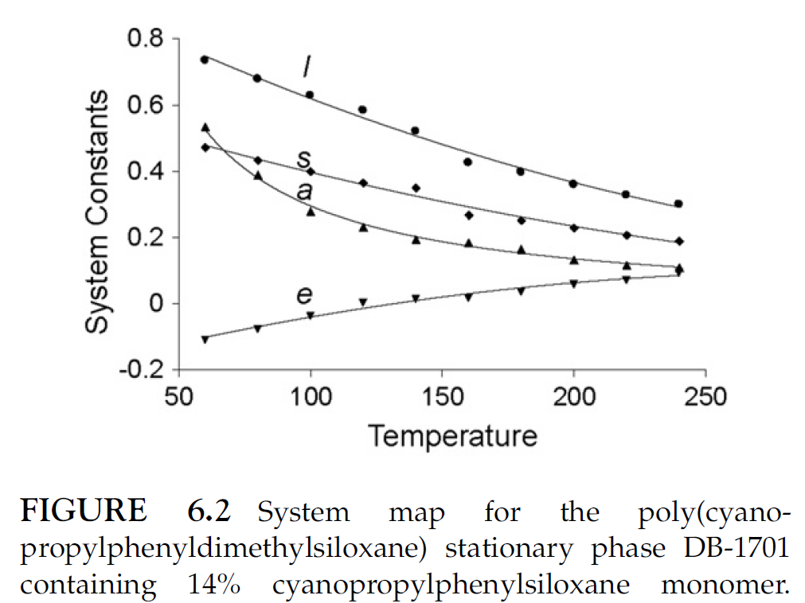
Column parameters: effect of temperature
(Poole, Gas Chromatography, Elsevier 2012)

Slide 19
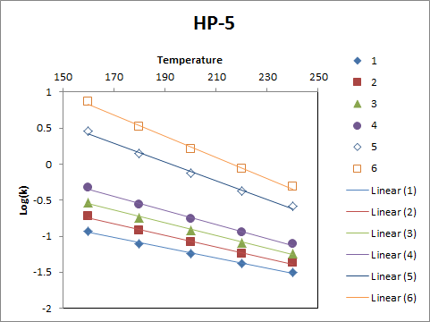
Estimation of log-retention factors, Log(k)
1 nonane
2 decane
3 undecane
4 dodecane
5 hexadecane
6 octadecane

Slide 20
Determination of solute parameters
Calculation from a physical property:
E is calculated from the molar refraction
2) Dermination from a gas-liquid partition coefficient:
L is determined from experimental values K(gas/n-hexadecane)
From direct measurements or GC-retention on a non-polar column
3) Determined from multiple regression using probe solutes
S, A, B from multiple regression of solutes with known E and L on
many columns with known solvation parameters e, s, a, b and l
Determination of E and L are independent and can be done in any order.
S, A, and B depends on E and L and must be determined after E and L

Slide 21
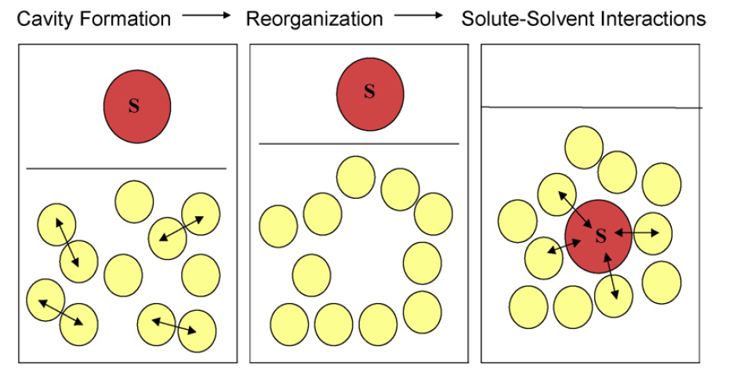
L-term: Cavity formation and dispersive
(non-polar) interactions
L = gas/liquid partition coefficient for the solute on n-hexadecane at 298 K
Endoergic small exoergic
Since the n-hexadecane has no dipole-moment, no acid or basic groups, and no π-electrons or lone-pairs, the solute-solvent intercations for the L-term are only dispersive, i.e. non-polar in nature

Slide 22
V-term: Cavity formation and dispersive
(non-polar) interactions
L = gas/liquid partition coefficient for the solute on n-hexadecane at 298 K
Endoergic small exoergic
The non-polar properties of the solute is only dependent on the volume of the solute. The McGowan’s volume is calculated as the simple sum of atom fragment conctants minus

Slide 23
E-term: Lone pair and π-electron interactions
E = [MR_{X}(analyte) – MR(alkane of the same volume)]/10
(≈homomorph alkane)
MR: Molar Refraction
Index of refraction, n_{i}:
v_{i}: Velocity of light in i
c: Velocity of light in vacuum
Vacuum Solvent
Light is slowed down relative to vacuum, because the electro-magnetic radiation interacts with the electrons in the matter
Thus the speed of light is inversely proportional to the polarizability of the molecules in the matter
Polarizability, α_{i}:

Slide 24
E-term: Lone pair and π-electron interactions
E = [MR_{X}(analyte) – MR(alkane of the same volume)]/10
E ∝ Polarizability(analyte) – Polarizability(alkane of same volume)
Polarizability due to
all other electrons,
i.e.:
The E-term is the interactions due to π-electrons and lone pairs
Polarizability due to all σ-electrons in the molecule:
This interaction is included in the L-term
If we did not subtract the contribution from an alkane with the same size as the solute, the polarizability of the σ-electrons will be included in both the experimental determined L-term and in the E-term

Slide 25
S-Term: Dipolar interactions
S: Interaction between polar solutes without hydrogen bond acidity and polar columns
Polar solutes and/or columns will have a dipole moment, and will be able to interact with a column through dipole-dipole interactions and/or dipole-induced dipole interactions
S is determined from retention data on a polar column for solutes, where E and L are known:
The S-term accounts for the retention, that cannot be explained by the general polarizability of the electrons in the solute. S is mainly explained by the dipoles in the solute and/or the solvent
Please note: Now we have a 3-parameter model. Any errors or inconsistency in the L and E-parameters will be included in the S-parameter. Thus there is some mixing of the effects between the parameters, and we should interpret the parameters with some caution: the effects are mainly due to dispersion (L), π-electrons and lone-pairs (E) and dipoles (S) – but not exclusively!

Slide 26
A and B -term: Solute hydrogen-bond interactions
A: Interaction due to solutes with hydrogen bond acidity
B: Interaction due to solutes with hydrogen bond basicity
A and B is determined from retention data on a polar column for solutes with hydrogen bond acidity or basicity, where E, S and L are known:
The A-term accounts for the retention, that cannot be explained by E, S and L. A is mainly explained by the acidity of the solute.
In practice, no commercial GC-stationary phases have any significant b-parameter, thus B is often neglected for GC, and B-values are determined from water-solvent partitioning:
But: GC-columns may have some residual acidity, which is mainly caused by the column support, the deactivation chemistry etc.
Thus the bB-term is in general small and of
little value for selection of stationary phases in GC

Slide 27
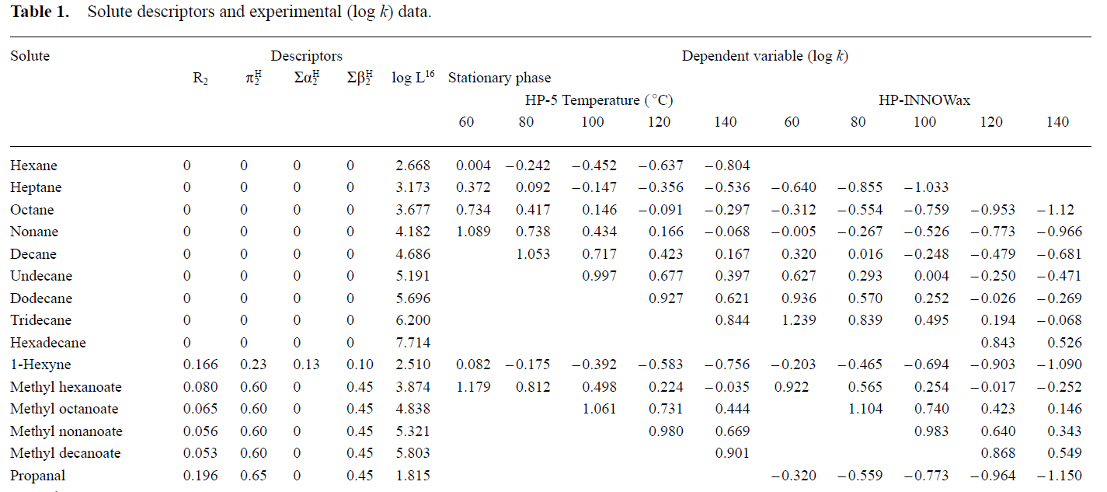
Column parameters c, e, s, a, b and l
Column parameters are determined from isothermal retention factors for a test set of solutes with known solubility model parameters by multiple linear regression:
E S A B L
Waruna Kiridena, Wladyslaw W. Koziol, Colin F. Poole and Qinglin Li, Characteristic Stationary Phase Constants for Two Popular Open-Tubular Column Stationary Phases for Gas Chromatography, J. High Resol. Chromatogr. 2000, 23, (10) 603–608

Slide 28
System maps
A system map is a plot of column parameters as function of temperature
OBS: Remember that solute parameters E, S, A, B and L are
independent of temperature
(Poole, Gas Chromatography, Elsevier 2012)

Slide 29
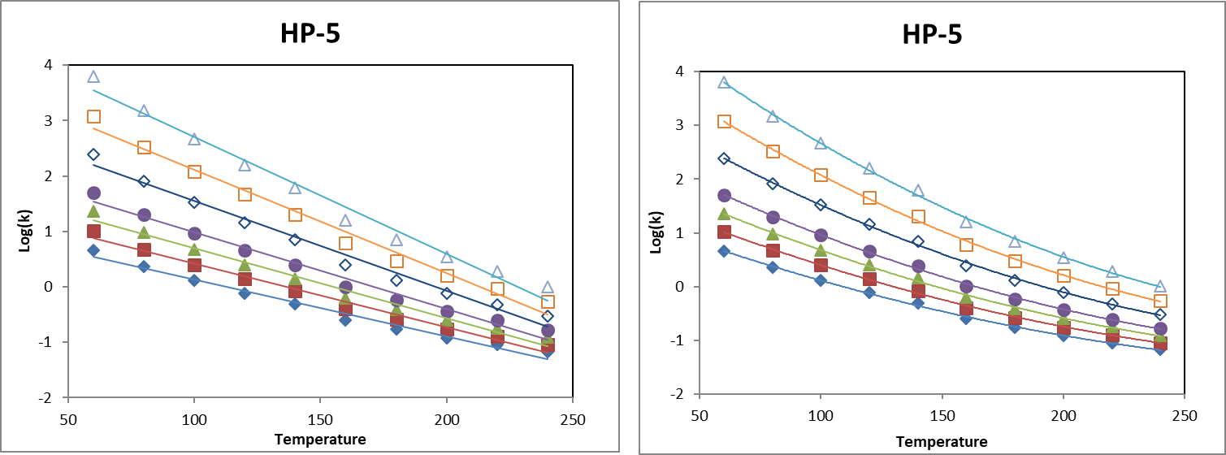
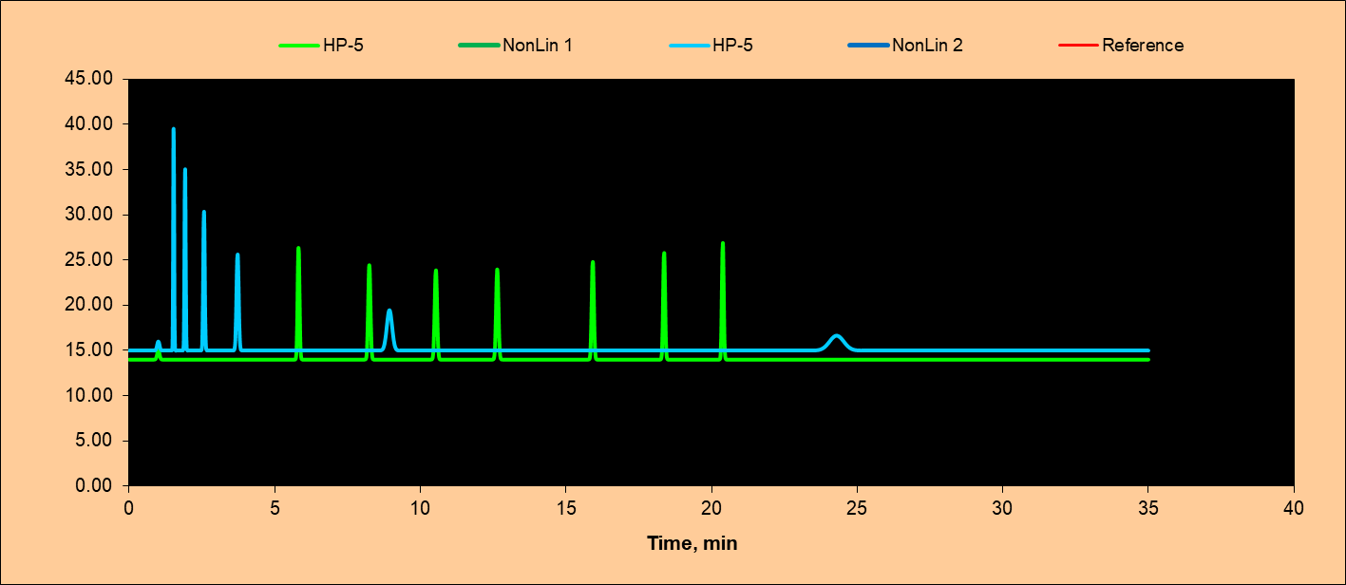
Prediction of Gas Chromatograms – ChromSimGC
HP-5
SP Parameters:
e, s, a, b, l, c
1 Nonane
2 Decane
3 Undecane
4 Dodecane
5 Tetradexane
6 Hexadecane
7 Octadecane
SP Parameters:
E, S, A, B, L
Linear 2nd degree
Isotherm
Temperture
program
t_{R}(octadecane) = 74 min) ->
HPLC: log(k) = Log(k_{w})-S⋅φ
GC: log(k) = log(k_{T0})-Slope⋅T

Slide 30
SPM comparison of columns
D
D
d
θ
θ
θ ≈ 0
D = Euclidean distance between the two vectors in 5-D space (e,s,a,b,l)
θ = Angle between the two vectors in 5-D space (e,s,a,b,l)
It two columns have a similar direction in the 5-D space – but different lengths, the only difference will be a parallel shift of all retention times
(Cos θ ≈ 1 and D > 0 i.e. θ and D do not indicate the same similarity)
For this reason it is better to use the normalized vectors of unit length:
d = Euclidean distance between normalized vectors [e,s,a,b,l]
Similar columns: Cos θ ≈ 1 d ≈ 0
Orthogonal columns: Cos θ ≈ 0 d ≈ Sqrt(2)
Opposite selectivity: Cos θ ≈ -1 d ≈ 2

Slide 31
Conclusion
Analytical Chemistry, PLEN
π-electron and lonepair interactions
Interactions with dipoles
Acid and basic hydrogen bond interactions
Cavity formation and dispersive interactions
Log(k) = Log(K)-Log(⋅β)
Constant, may include Log(β)
(δ_{p})
(δ_{h})
(δ_{d})
Solute-solvent and solute-column interactions can be explained by:
  Dispersive interactions lL δ_{d}
  Polar interactions eE and sS δ_{p}
  Hydrogen bond interactions aA and bB δ_{h}
  Ion-ion interactions (Liquid Chromatography)
Solute parameters: E,S,A,B,L Independent of temperature !
Column parameters: e,s,a,b,l,c Depends on temperature !
Dias 31

Slide 32


