Slide 1
Intercepts in calibration
What affects the intercept?
Force the line through zero?
Workbooks for regression
Bo Svensmark
Analytical Chemistry
ECP, PLEN

Slide 2
Linear regression, Y = Intercept + Slope⋅X ?
and
So the intercept is a function of the slope – they are not statistically independent
The true statistical independent parameters for linear regression are:
and
ALL ordinary least square lines passes through the mean!

Slide 3
How do the data-points affects the slope and the mean?

Slide 4
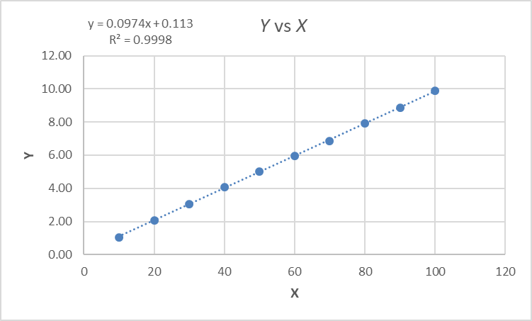
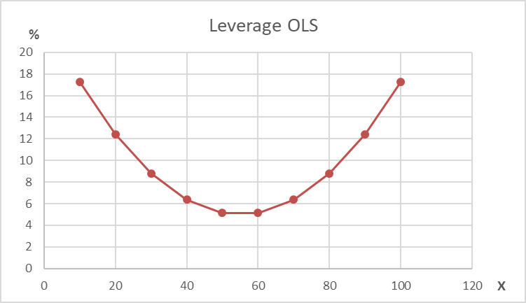
Leverage – equidistant concentrations

Slide 5
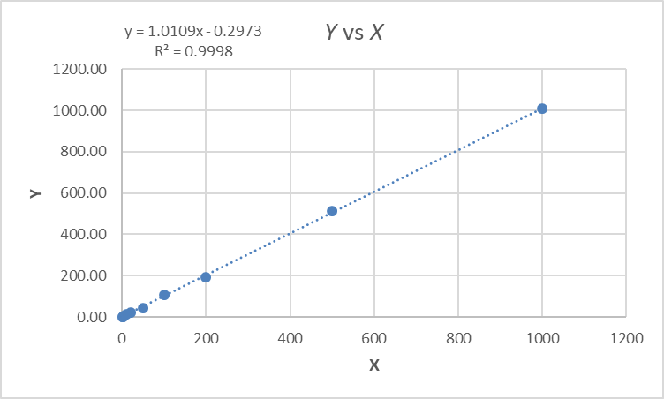
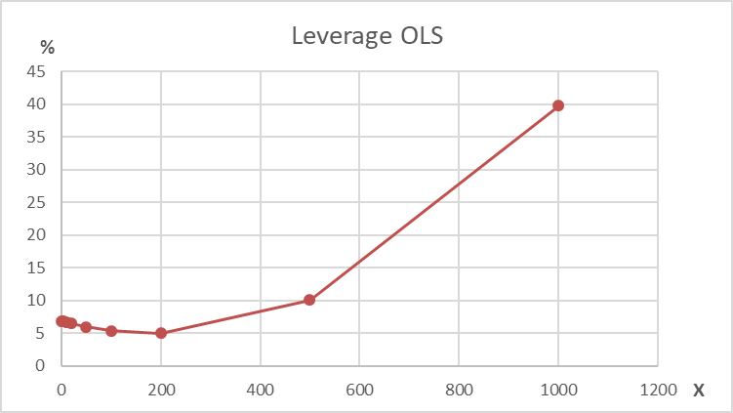
Leverage – non equidistant concentrations
The two highest concentration holds 50 % of the leverage!
This means that the
intercept is mainly controlled by the two highest concentrations!

Slide 6
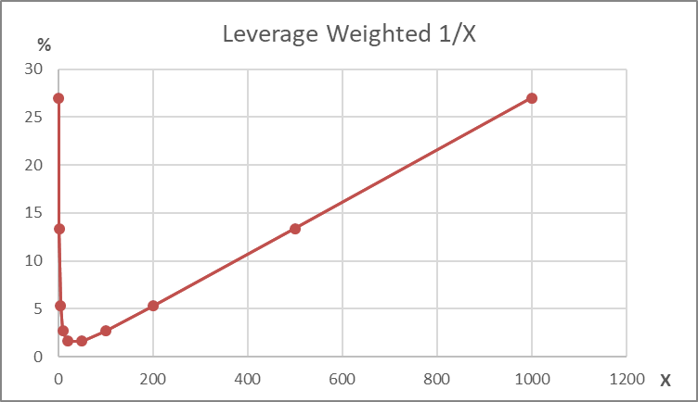
Leverage – 1/X weighted regression

Slide 7
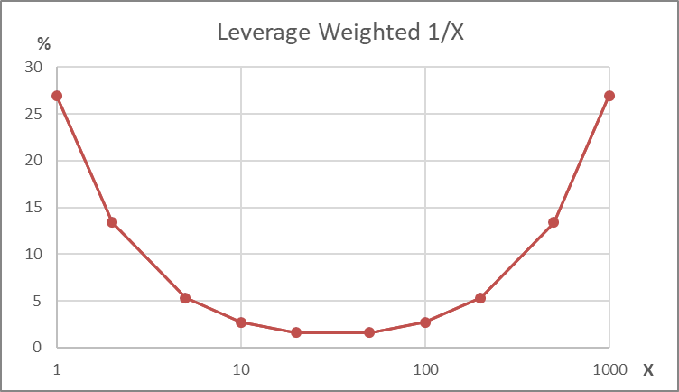
Leverage – 1/X weighted regression vs OLS
OBS: Logarithmic X-scale
Linear X-scale
Weighting with 1/X do approximately make leverage for exponential increasing concentration series equal to leverage for equidistant concentrations!
FYI: The curve leverage vs log X is a catenary– the shape of a free hanging chain

Slide 8
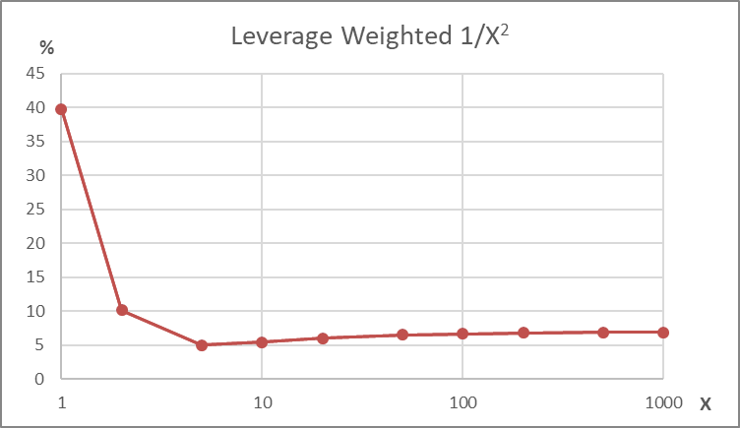
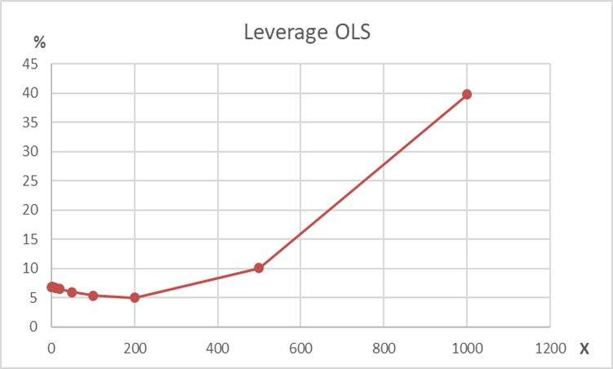
Leverage – 1/X² weighted regression?
OBS: Logarithmic X-scale
The two lowest concentration holds 50 % of the leverage!
This means that the intercept is mainly controlled by the two lowest concentrations
The ‘prize’ is that the calibration function for high concentrations may be quite wrong
Conclusion: Weighting 1/X will in most cases be far the best

Slide 9

Effect of mean of OLS vs mean of weighted regression
The same difference in the slope will have a much smaller effect on the intercept in weighted regression than in OLS
Bad because:
Slope determined mainly by high concentrations
Mean is far from X = 0
Good because:
Slope determined by all points
Mean is close to X =0

Slide 10
Effect of R²
For OLS:
The slope(Y on X) will (most likely) decrease when R² decreases
- and the intercept will increase....
Best alternative for
functional relation:
Orthogonal regression (λ = 1), or “Deming regression” (all λ)

Slide 11
Force the calibration through zero – or not?
With a proper calibration function (weighted 1/X ?) the intercept should be approximately correct, and there will be no gain in forcing through zero
If the detection limit DL is correct, it is impossible to get negative concentrations above DL.
If the intercept is not statistically significant different from zero, the calibration can be forced through zero
  But since it is not significantly different, there should be no real difference?
Forcing through zero may be beneficial for very low concentrations, but the overall accuracy will decrease (the residual variance will increase)

Slide 12
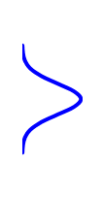
Reasons for negative concentrations caused by high intercept
Too high lowest concentration in calibration standards
OK to force zero –
Better to extend standards
with low concentrations

Slide 13
Reasons for negative concentrations caused by high intercept
Blank value has decreased
Force zero – very bad statistics
and slope too high
X o = (Yo - blank)/Slope
Better alternative

Slide 14
Reasons for negative concentrations caused by high intercept
Other cases:
Matrix effects different for analyte and internal standard
  Too high concentration of internal standard
  Internal standard different from analyte (apart from isotopes)
And many other reasons for different response for standards and samples…
No way to get a correct concentration from external calibration with a single result for the unknown samples
Solutions:
Xo = (Yo-?)/Slope may be a better alternative than force zero
Change to standard addition
More complicated setups e.g. with internal standards at different concentrations

Slide 15
Workbook Calibration_Dual_5.1.xlsm*
Weighted and unweighted least square linear regression and polynomial regression of 2nd and 3rd degree.
The calibration functions forced through zero – or not
Output includes
  Calibration function and all statistics
  Unknown concentrations with uncertainties (Standard deviation or Confidence intervals)
  Unkown concentrations are rounded to significant digits
  Detection and quantitation limits (DL, LOD and LOQ)
Batch mode has been added
  Automatic run of many analyst
  Automatic selection of best calibration function
  Automation can be overruled manually
12 cases:
3 degrees: 1 – 2 – 3
Weighted / not weighted
Force zero / or not
*All my workbooks (Calibration, Chromsim, DoE, Theory of Sampling…)
can be found on my homepage: bosvensmark.dk

Slide 16
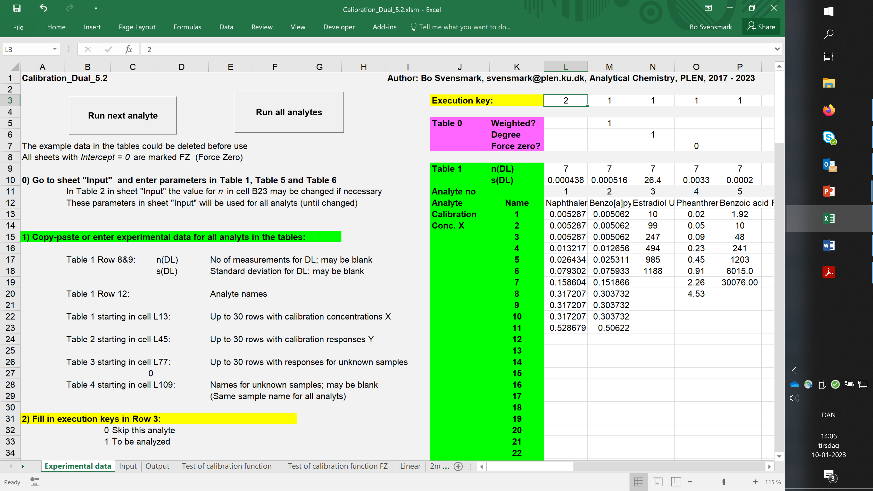
Notes:
For automatic analysis enter experimental data in this sheet.
Instructions for data input and for use of the automatic functions are given in details in this sheet.

Slide 17
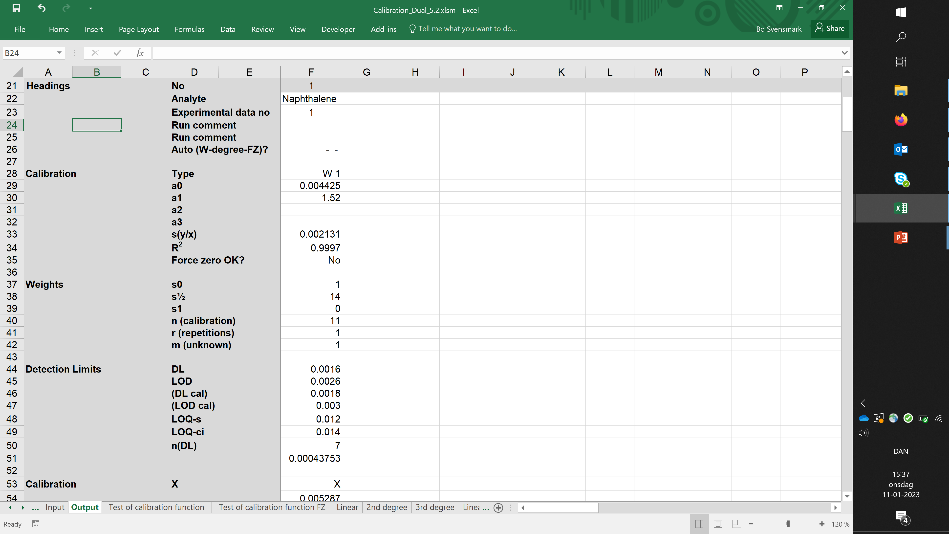
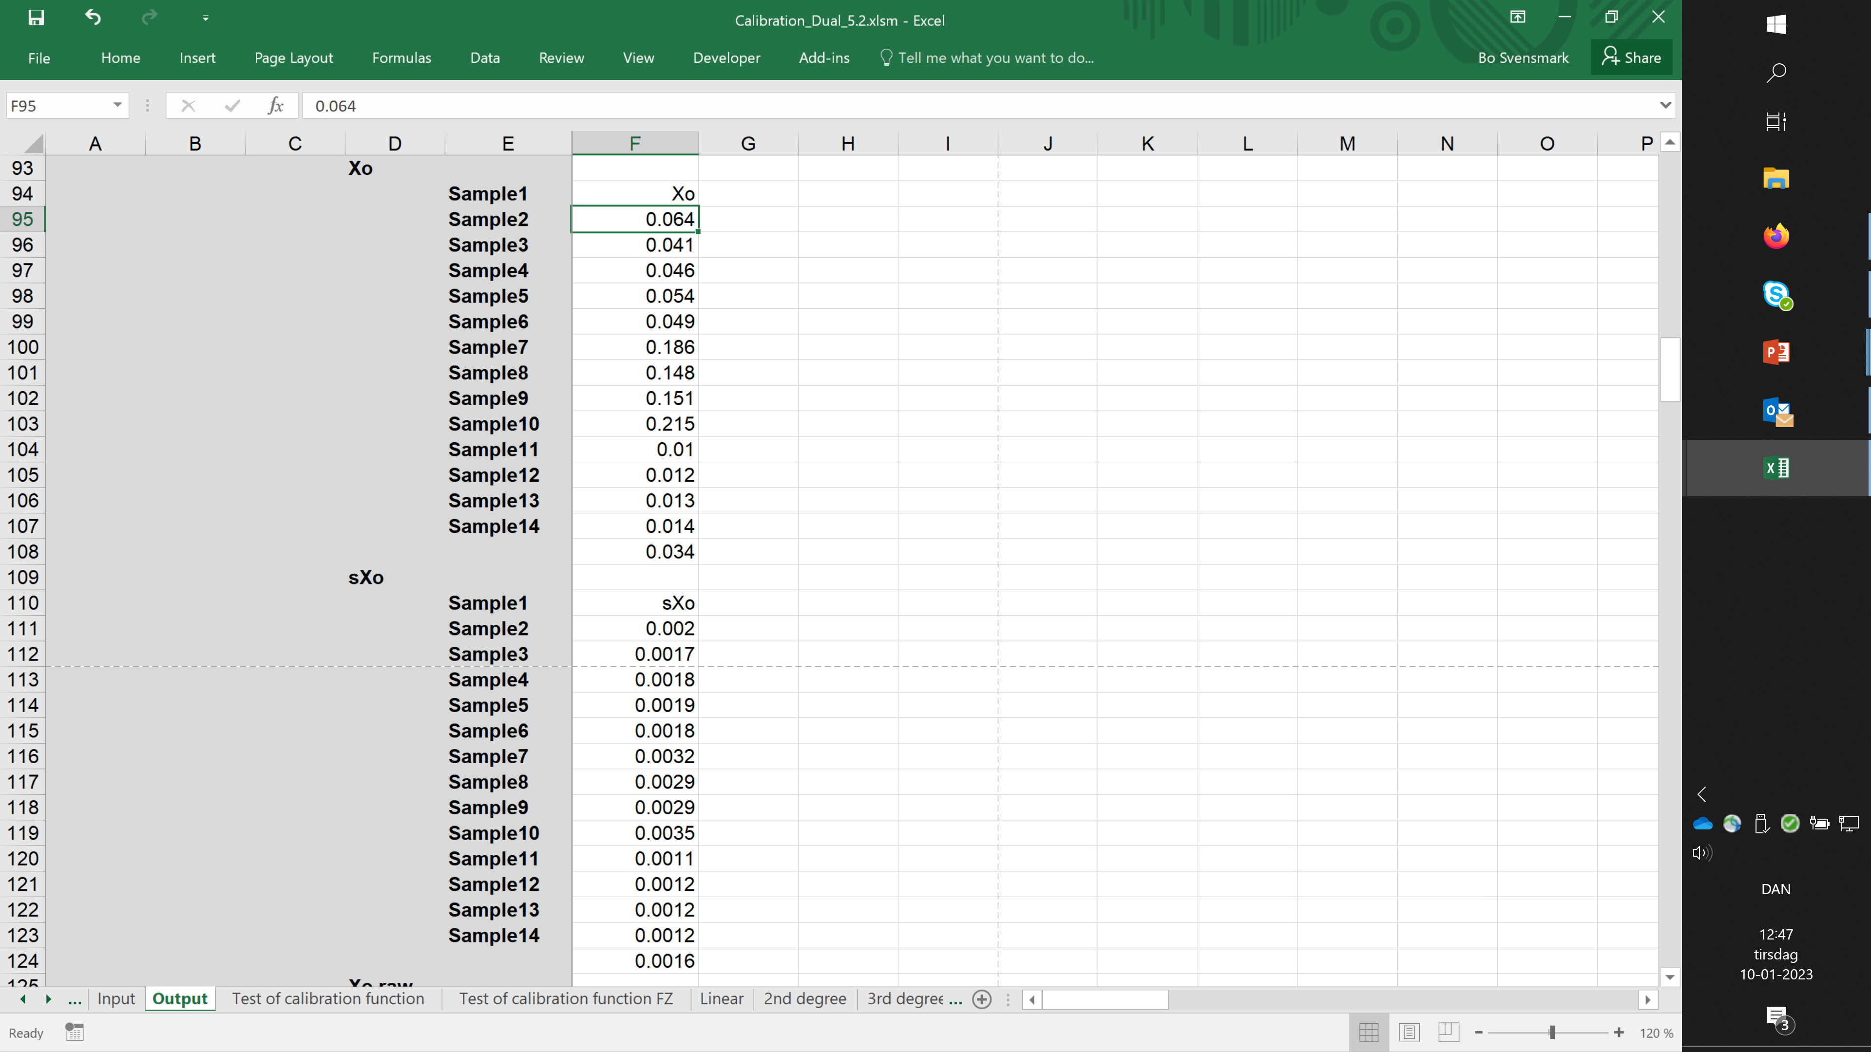
Xo = ROUND(X; – INT(Log10(sXo))
sXo = ROUND(sXo; 1 – INT(Log10(sXo))
Notes:
Start: Calibration function including parameters and statistics
First click: Output of concentrations of unknown sample – not Xo rounded to significant digits
Second click: Expression for rounding Xo
Third click: Expression for rounding sXo to 2 significant digits
(not in the output (first click) that the first entry sXo for Sample 1 is printed as 0.002 and not 0.0020.
The reason is that Excel do not print trailing zeroes, unfortunately)

Slide 18
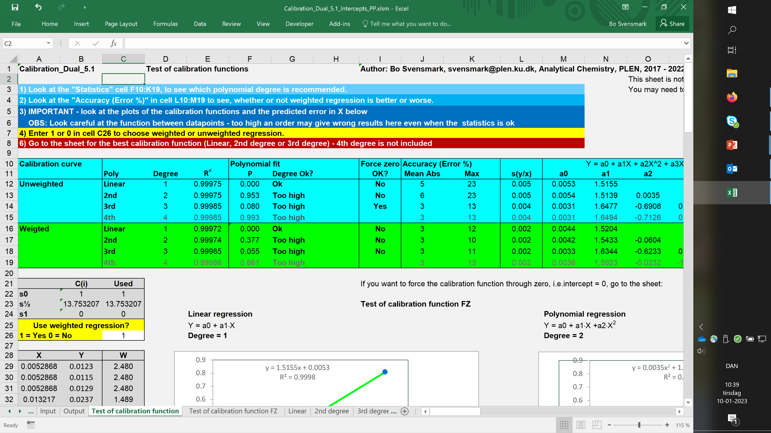
Notes:
After the analysis you can always go back to the intermediate sheets and check the results.
Here we see that Weighted linear degree regression is the best (W 1 in the output sheet).

Slide 19
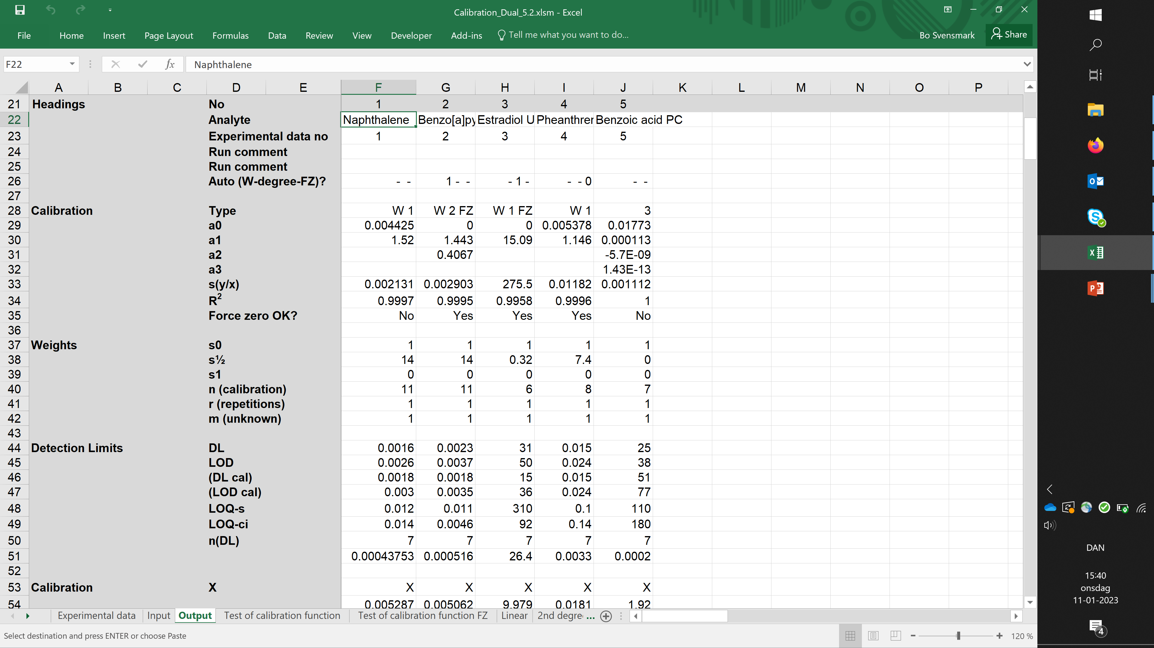
Notes:
After automatic analysis of many analyst, we can only se the intermediate results for the last analyte.
Note that Phenanthrene was run without forcing the line through zero (although it would have been ok),
This is because the automatic choice was overruled by the parameter = 0 for Force zero?
Benzoic acid was run with a 3rd degree polynomium, which is unusual and should be checked (next slides)

Slide 20
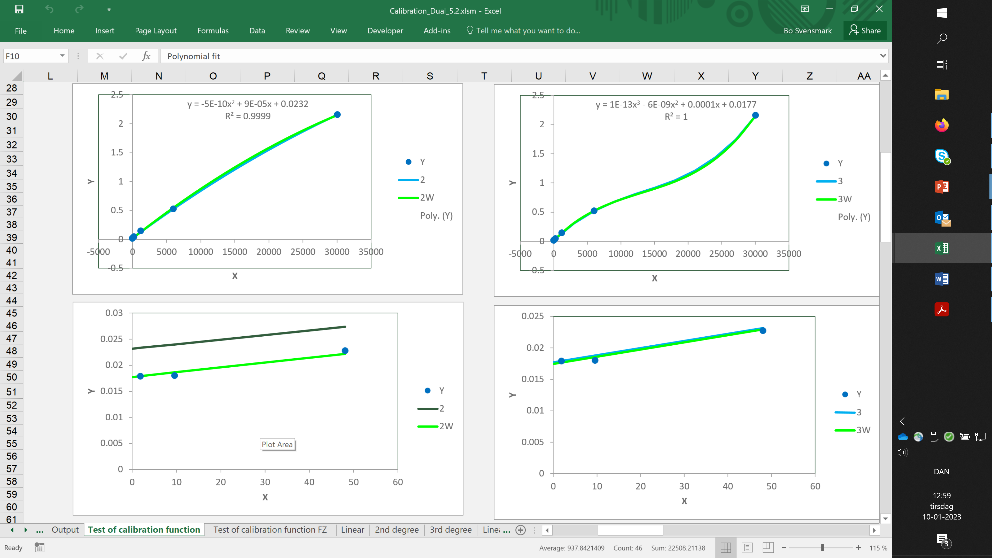
Notes:
The statistics is slightly in favour of 3rd degree polynomium without weighting –ok?
First click: 3rd degree is best for the points, but between the points it is not ok for a calibration curve.
From the plots, weighted 2nd degree calibration is selected as the most reliable function.

Slide 21
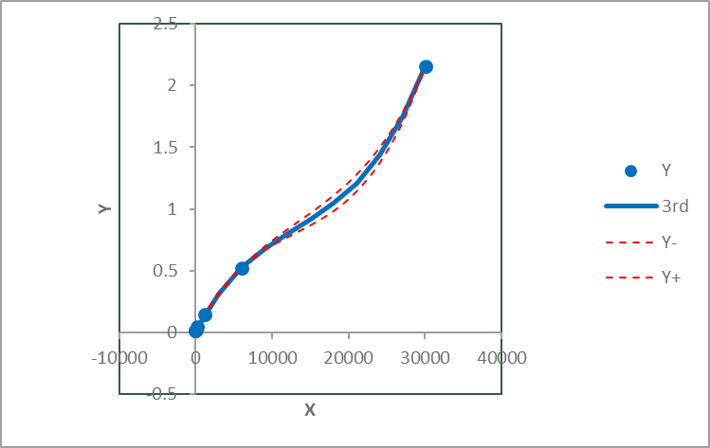
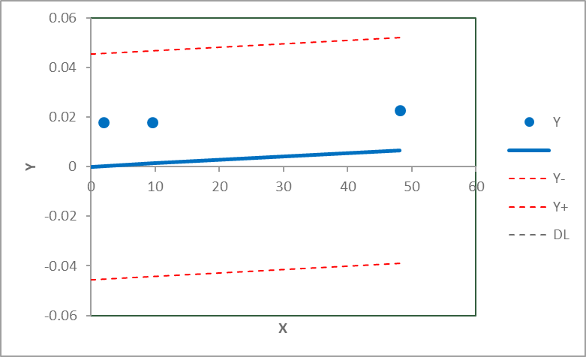
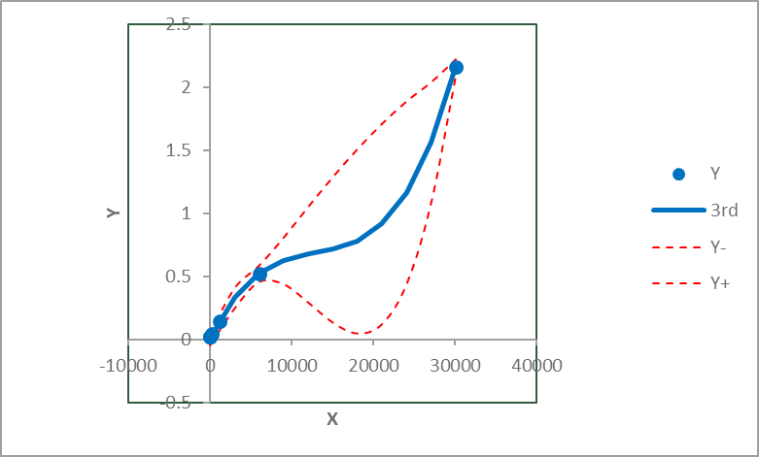
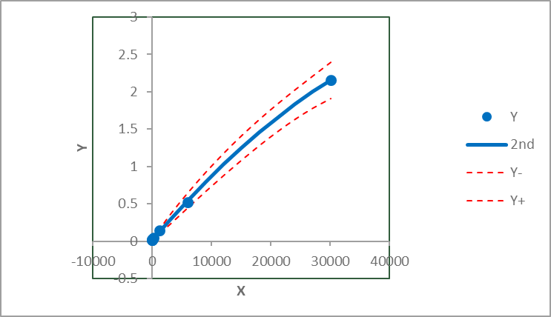
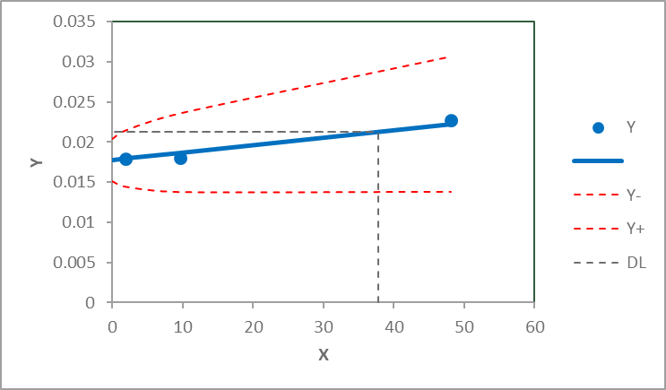
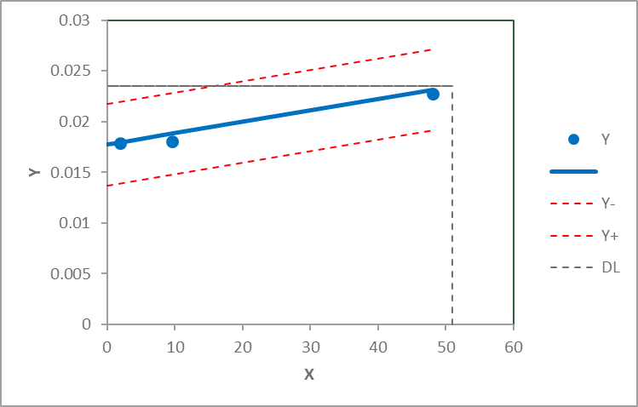
A worst case – too high degree (3) and force zero
3rd degree polynomia and calculated intercept – automatic choice
OK with weighted 2nd degree polynomia (1/x) and calculated intercept
Notes:
Forcing though zero (is obviously a bad choice), but it shows that the residual variance is very high
In this case giving a huge prediction interval.
First click: The automatic choice is much better, but still looks really bad between the two last points.
Second click: Weighted 2nd degree regression seems fo be a quite good calibration function.

Slide 22
Conclusion
Be carful to include calibration standards at a very low concentration, when the
unknown samples includes very low concentrations.
With exponentially increasing concentrations of the calibration standards
(or similar series like 1- 2 – 5 -10 -20 – 50 -100 – etc). weighting 1/X will in general give very good results.
In my calibration workbooks, weight parameters (s0, s1, s1) = (1, 1, 0)
in Table 5 in sheet Input will in general give good results, also for detecetion limits.
For automatic analysis in my workbooks, follow the instructions in the sheet
Experimental data. In general use Analyse next analyte and check the intermediate results in the other sheets before proceeding to the next analyte – the automatic statistically best choice may not be the best in all cases!

Slide 23

Andre Budzien World Champion OK Dinghy 2012

Slide 24
Uncertainties in calibration
An error or an uncertainty in X is transformed into a variation in Y:
A) 3 injections of the same conc.
B) 3 injections of 3 slightly different conc.
B) But the results is assumed to be at the nominal conc.
s_{X}
s_{Y}
Xo
Xo
Nominal conc.
Xo
Nominal conc.

Slide 25
Effect of R²
For calibration, an error in X is transformed into an error in Y:

