Slide 1

Least square calibration
Bo Svensmark
Analytical Chemistry
PLEN
University of Copenhagen
svensmark@plen.ku.dk

Slide 2
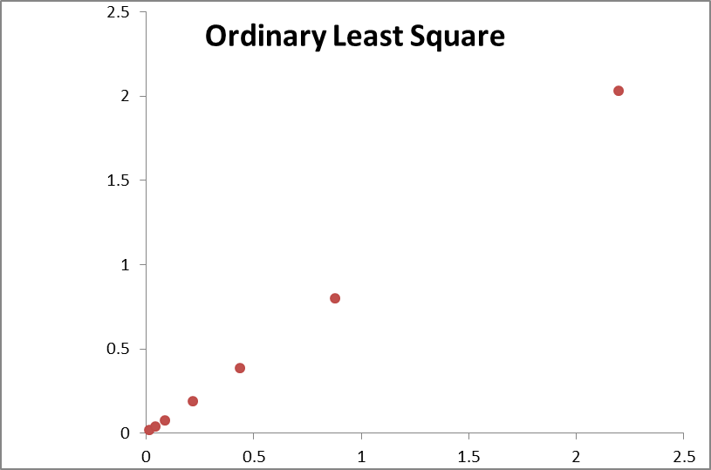
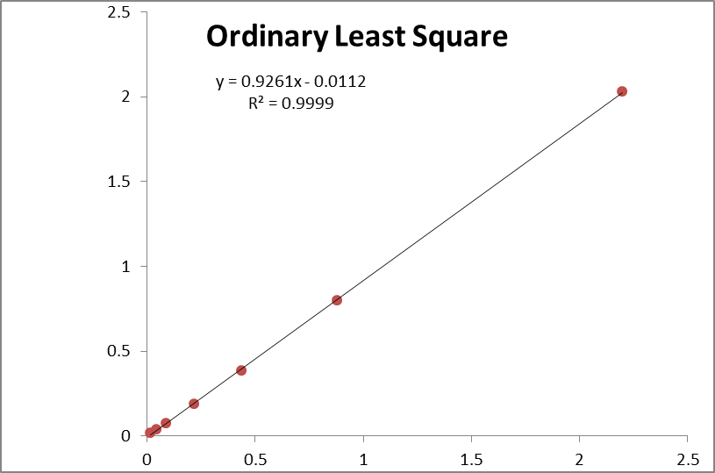
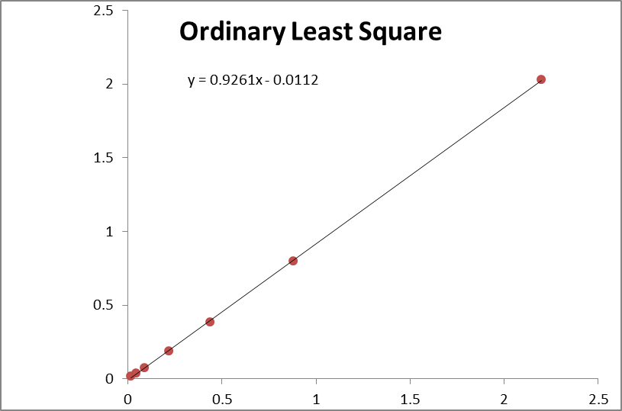
Linear calibration
Measure the response for a series of known concentrations
Plot the response as function of concentration
Check the linear range
Make linear regression Y = a₀ + a₁X
If R² > 0.99 we conclude that: - the response is linear - we can use the calibration line for quantitative analysis
NO – this may not be OK at all!
Errors could be > 100 %

Slide 3
What may be wrong with R² >0.99
The random errors are not independent of concentration
In most cases random errors will be a combination of
Constant error – independent of concentration
Counting error – proportional to square root of concentration
Proportional error – proportional to concentration
Proportional
Square root
(most detectors)
Constant
Std. Dev.
Concentration
What to do about random errors dependency of concentration:
Use weighted least square regression
Weights inverse proportional to the error²

Slide 4
Least square linear regression
To obtain the line: y = a₀+ a₁x
We must minimize the sum of the least squares (weighted):
σ_{B}
σ_{A}
x_{A}
x_{B}
Error | Weight
Constant | C₀
Square root | C_{½}/X
Proportional | C₁/X²
All (const + sqr + prop) | 1/(C₀ + C_{½}Sq(X) + C₁X)²

Slide 5
Input of weights in spreadsheet Calibration
The contributions is expressed as the standard deviation in the response at the conc. of the lowest standard in the calibration:
So: Constant uncertainty: sY independent of conc.
S½: Counting uncertainty: sY proportional to sqrt(conc.)
S1: Proportional uncertainty: sY proportional ton conc.
Proportional
Square root
(most detectors)
Constant
Std. Dev.
Concentration

Slide 6
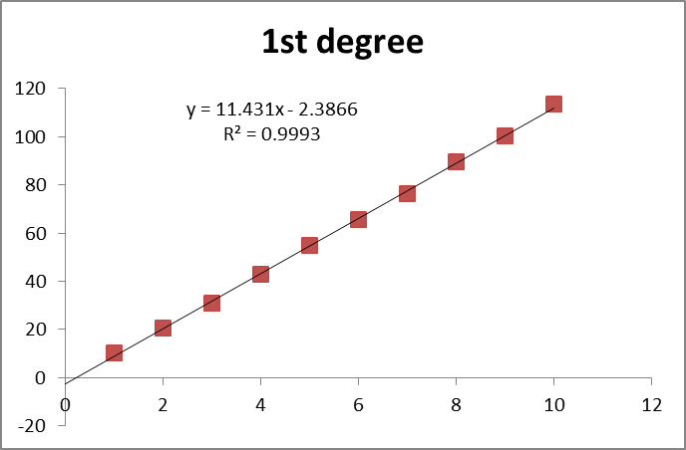
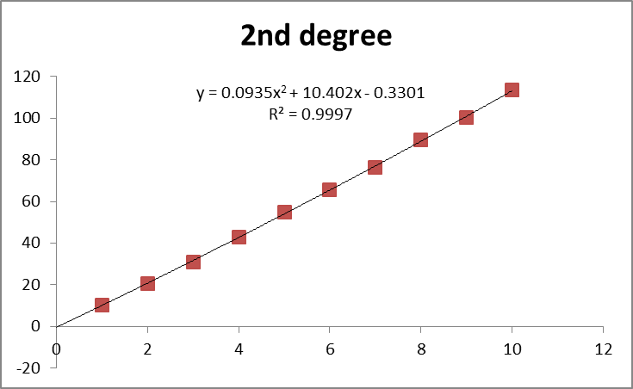
What may be wrong with R² >0.99
2) There are systematic errors
The response may bend downward at high concentrations
The response may bend upward at low concentrations
What to do about systematic errors :
Use polynomial least square regression of degree > 1
Most often a quadratic equation: Y = a₀ + a₁X + a₂X²

Slide 7
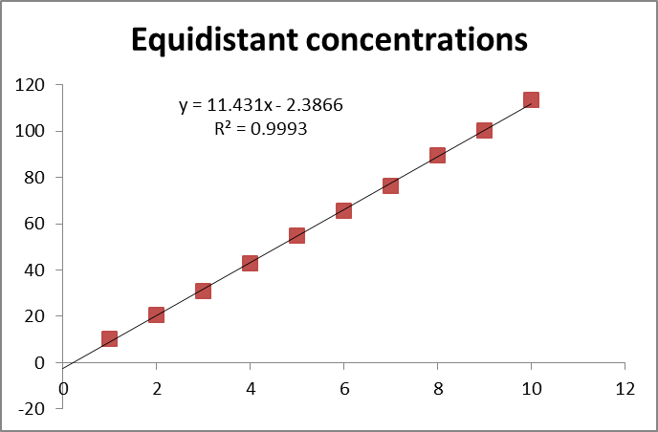
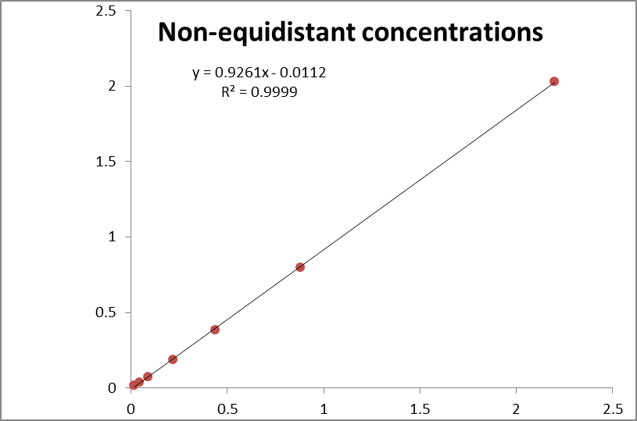
What may be wrong with R² >0.99
3) The concentrations in the calibration are not equidistant
This is normal for methods with MS-detection
Only a problem if:
  Uncertainty depends on concentration and/or
  There are systematic errors
THIS means: IT IS ALWAYS A PROBLEM for non-equidistant concentrations
Used for methods or problems with restricted dynamic range, e.g.:
AAS
UV/VIS spectrometry
Used for methods with long dynamic range, e.g.:
MS-detectors
FID in GC
Ionselective electrodes

Slide 8
So –what to do?
Equidistant concentrations | Systematic error absent | Uncertainty independent of concentration | Unweighted linear | Weighted linear | Unweighted polynomial | Weighted polynomial
Yes | Yes | Yes | X
 |  | No |  | X
 | No | Yes |  |  | X
 |  | No |  |  |  | X
No | Yes | Yes | (x)*
 |  | No |  | X
 | No | Yes |  |  | (x)*
 |  | No |  |  |  | X
*Very unlikely
Linear or polynomial regression?
Compare R² for degree 1, 2, …
This statistic test is very easy
Unweighted or weighted regression?
Look on the accuracy of the regression
Is the predicted concentrations with a good enough deviation from the correct value?
The Excel spreadsheet with all tests and calibration methods
is available at Absalon
Examples will be shown on the next slides

Slide 9
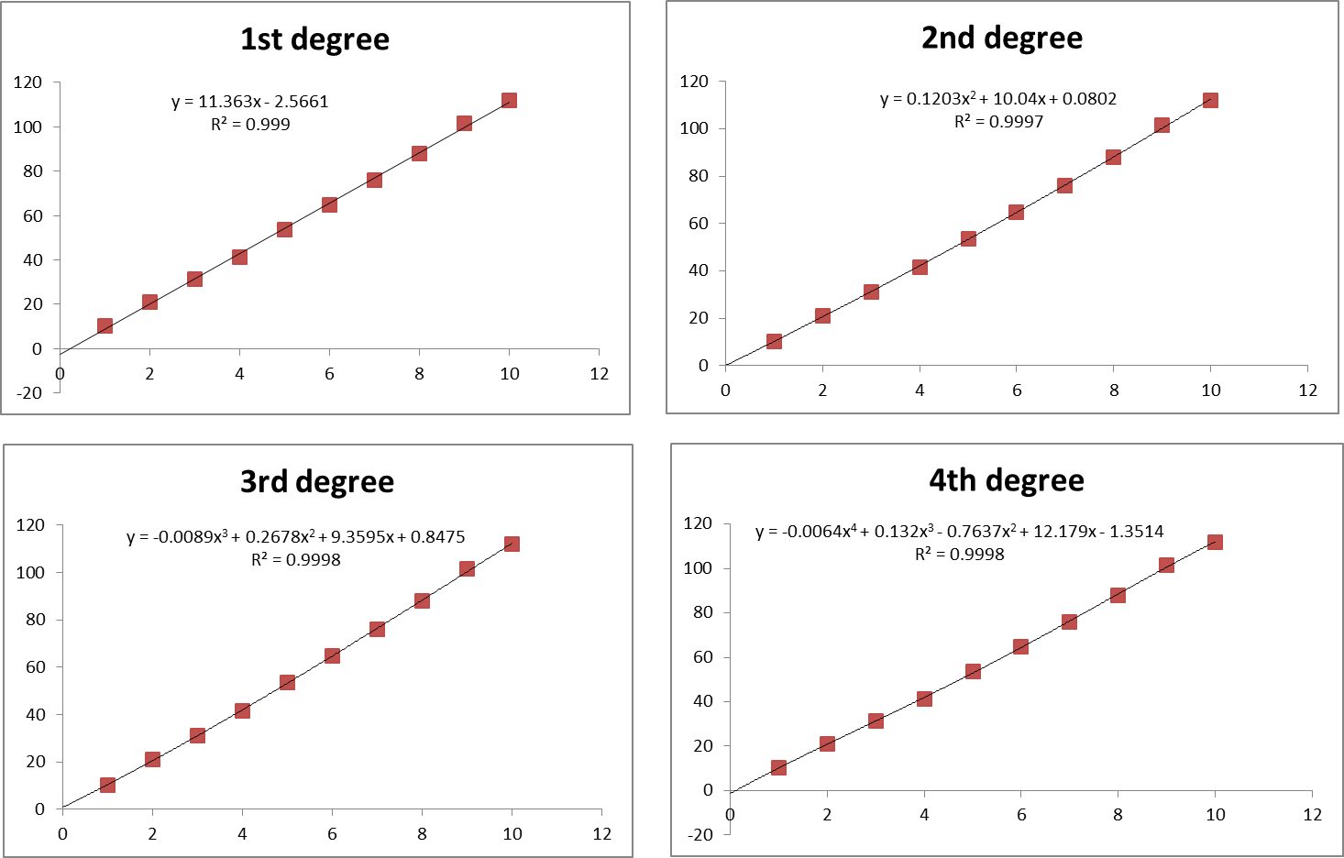
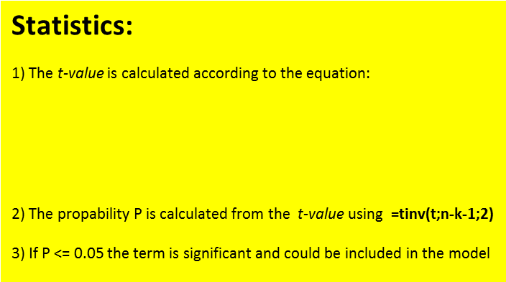
Linear or polynomial regression?
Do it in Excel: Make linear regression with the Data Analysis -> Regression:
Look at the P-value for the highest degree of X:

Slide 10
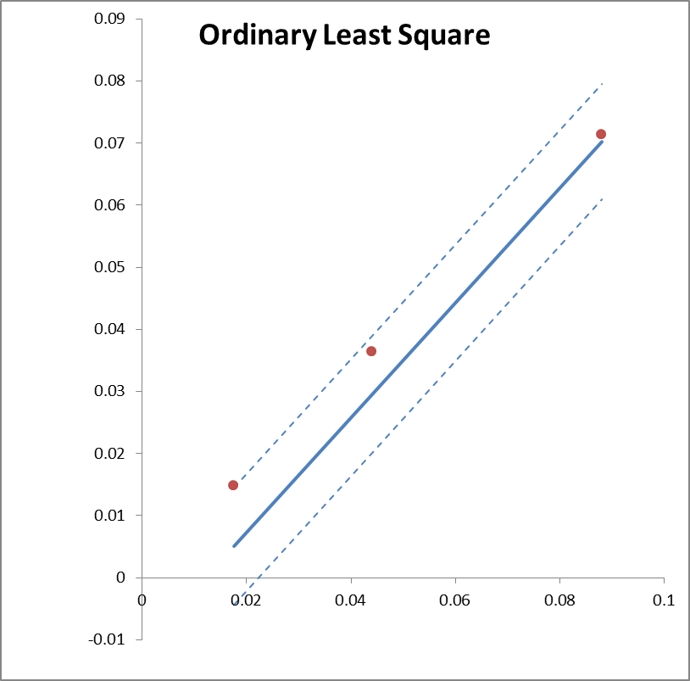
Unweighted or weighted regression?
Ok?

Slide 11
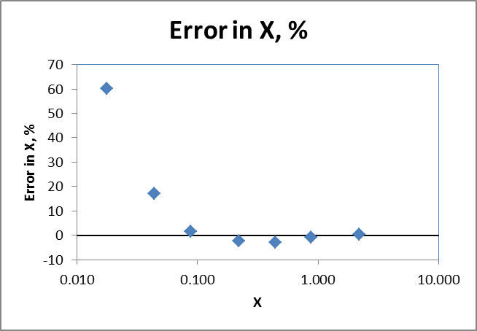
Unweighted or weighted regression?
The accuracy of the regression can be estimated in this way:
Calculate the estimated X-values from the observed Y-values
Calculate the % error in the estimated X-values
Look at the error as function of X

Slide 12
Unweighted or weighted regression?
So – even for R² = 0.99994, the concentration inside the calibration range can be in error by 60 %

Slide 13
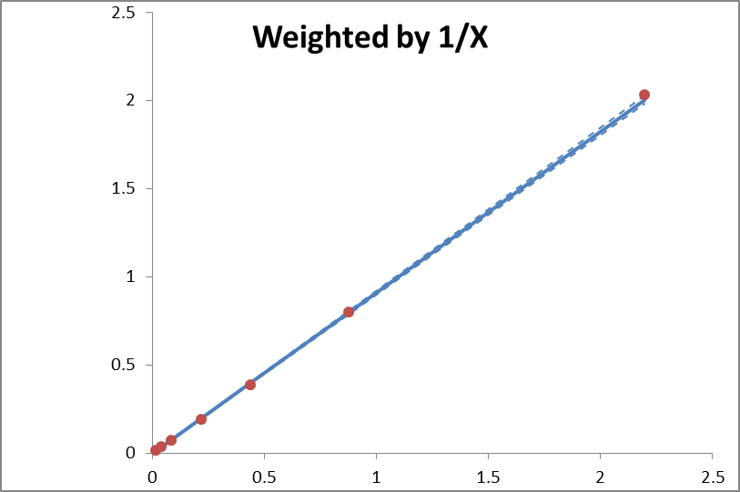
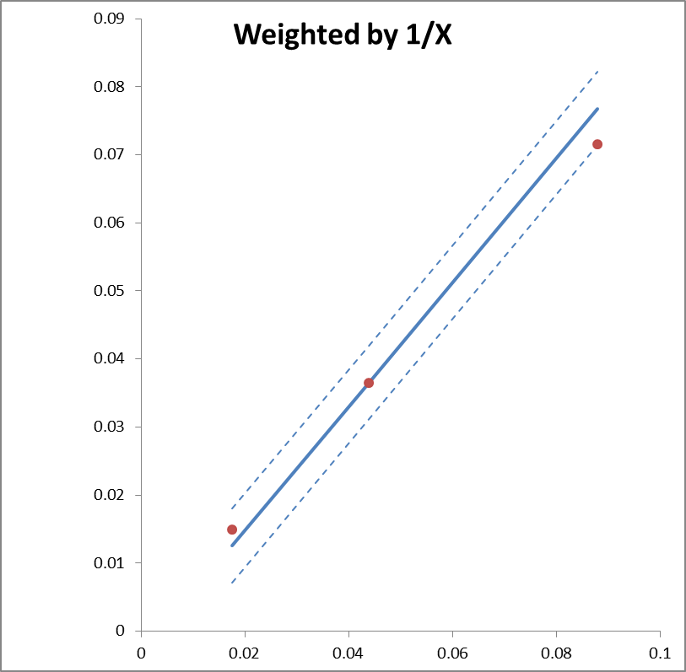

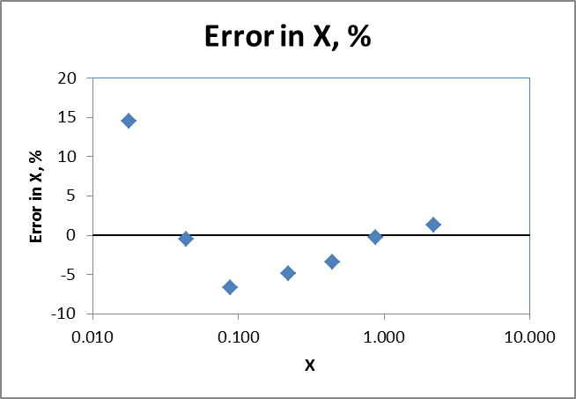
Weighted linear regression, W_{i} = 1/X_{i}

Slide 14
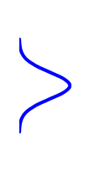
Repeat measurements
A) Dependent: Several injections from the same vial/solution
B) Independent: Several solutions prepared for each concentration or sample and injected from separate vials/solutions
Use the mean Y
N = no. of conc. = j
s_{Y} from i repeat injections
B) Use all Y as independent runs
N = repetitions*conc. = i*j
s_{Y} from i independent runs
Xo
Xo
Nominal conc.

Slide 15
Repeat measurements
A) Dependent: Several injections from the same vial/solution
B) Independent: Several solutions prepared for each concentration or sample and injected from separatet vials/solutions
A) 3 injections of the same conc.
B) 3 injections of 3 slightly different conc.
B) But the results is assumed to be at the nominal conc.
Xo
Xo
Nominal conc.
Xo
Nominal conc.

Slide 16
Errors in concentrations?
A) Dependent: Several injections from the same vial/solution
So, what is the best calibration function:
LINEAR with a bad fit to points
SECOND DEGREE with better fit?
All statistics points to 2nd degree
R², Error %, Lack of Fit
But the most accurate would be:
LINEAR
Because it levels out the errors instead of modelling them

Slide 17
Sequential dilutions
Start with the highest conc. and dilute to next conc., then dilute this to the next and so forth…
Y = 0.1*X One conc. error at X = 500

Slide 18
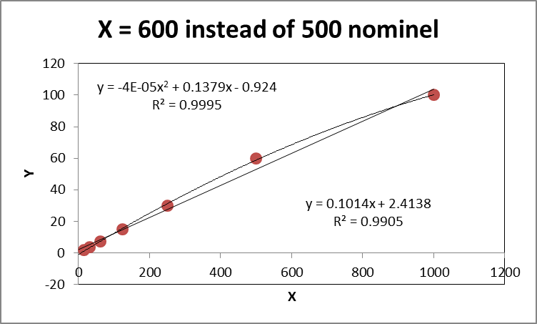
Sequential dilutions
Start with the highest conc. and dilute to next conc., then dilute this to the next and so forth…
The problem is, that it LOOKS very nice even when it is wrong…

Slide 19
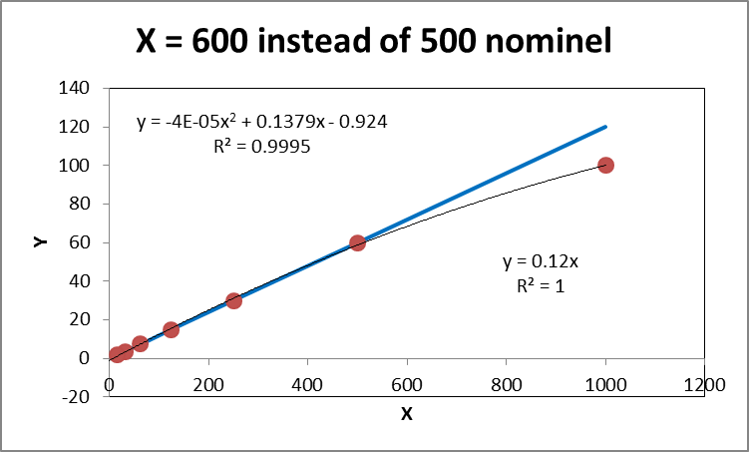
Sequential dilutions
Start with the highest conc. and dilute to next conc., then dilute this to the next and so forth…
And furthermore, it looks as if the last point is in error – but it is actually the only correct point…

Slide 20
Sequential dilutions
Y = 0.1*X 10 % error in dilutions up/down

Slide 21
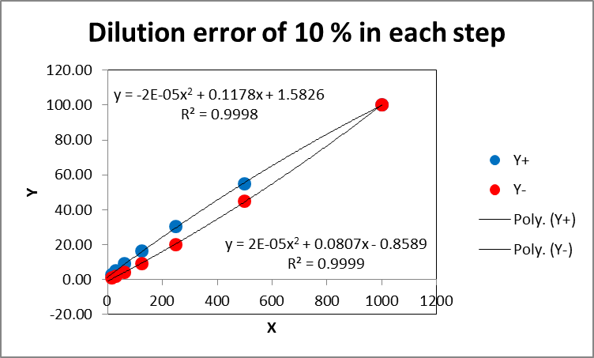
Sequential dilutions
Conclusion for sequential dilutions:
LOOKS NICE – AND HIDES ERRORS!

Slide 22
Prepare calibration solutions independently
Errors will be at random concentrations giving:
MORE VARIATION – AND MORE CORRECT RESULTS
Be careful NOT TO OVERFIT (use too high degree and model noise)
Be aware of SYSTEMATIC ERRORS (% dilutions ect.)

Slide 23
Conclusion
Always plot the data: –both for the whole range, and for low concentrations
Always test R² to see, if a linear or polynomial regression should be used
Always look at the error in X to see if a weighted regression should be used
Never ever trust R² alone as measure for linearity or goodness of fit
Do not use sequential dilutions looks nice, hides errors!
Do not overfit do not use too high order and model noise or error!
Do not trust statistics blindly it is only a guide!
FINAL DECISION Look at the plots - use all your knowledge about the method!

Slide 24

Gannet - Sule

